Slide 1
“a purple prickly metallophone meatloaf”

Slide 2
“a purple prickly metallophone meatloaf”

Slide 3
“a purple prickly metallophone meatloaf”

Slide 4
“a purple prickly metallophone meatloaf”

Slide 5
“a purple prickly metallophone meatloaf”

Slide 6
“a purple prickly metallophone meatloaf”

Slide 7
“a purple prickly metallophone meatloaf”

Slide 8
“a purple prickly metallophone meatloaf”

Slide 9
“a purple prickly metallophone meatloaf”

Slide 10
“a purple prickly metallophone meatloaf”

Slide 11
“a purple prickly metallophone meatloaf”

Slide 12
“a purple prickly metallophone meatloaf”

Slide 13
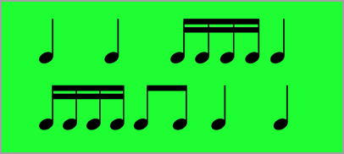
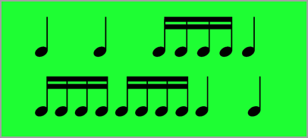
“a purple prickly metallophone meatloaf”

Slide 14
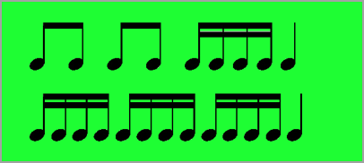
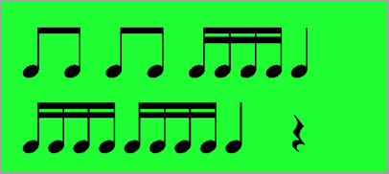
“a purple prickly metallophone meatloaf”

Slide 15
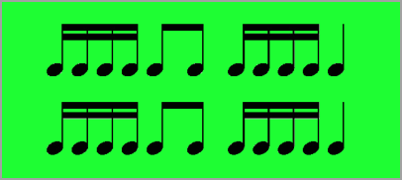
“a purple prickly metallophone meatloaf”

Slide 16
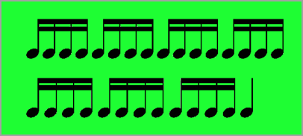
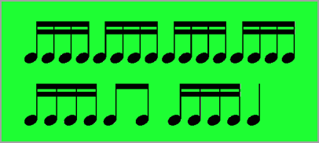
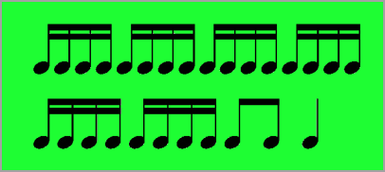
“a purple prickly metallophone meatloaf”

Slide 17
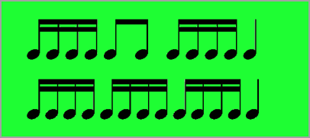
“a purple prickly metallophone meatloaf”

Slide 18
“a purple prickly metallophone meatloaf”

Slide 19
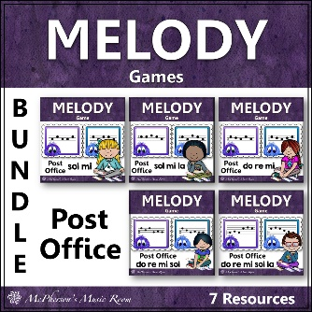
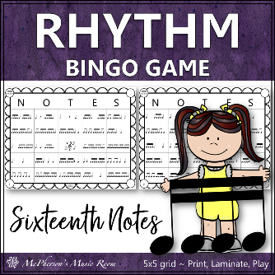
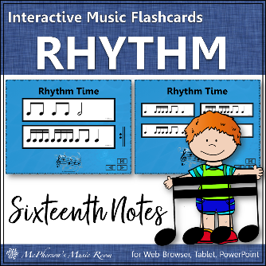
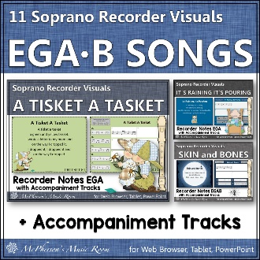
“a purple prickly metallophone meatloaf”

Slide 20
“a purple prickly metallophone meatloaf”

Slide 21
Leprechaun licensed by Scrappin’ Doodles
Background licensed Steach4fun
Frames licensed by The Candy Class
Font licensed by Kimberly Geswein Fonts and Font Bundles
Sound Effects licensed by Pond 5
“a purple prickly metallophone meatloaf”

