Slide 1


Begin

Slide 2

Begin

Slide 3
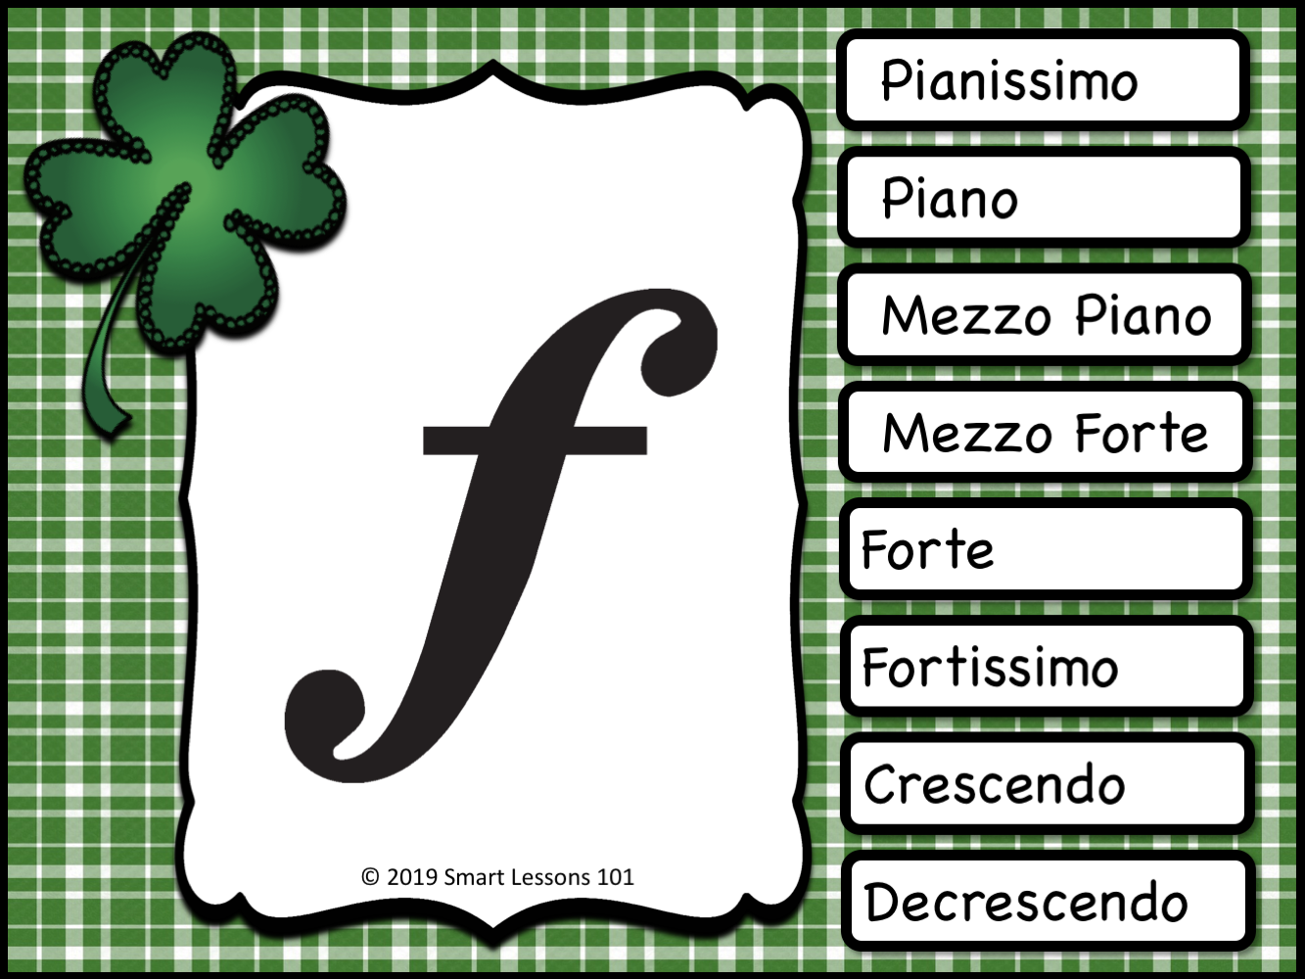

Slide 4


Slide 5
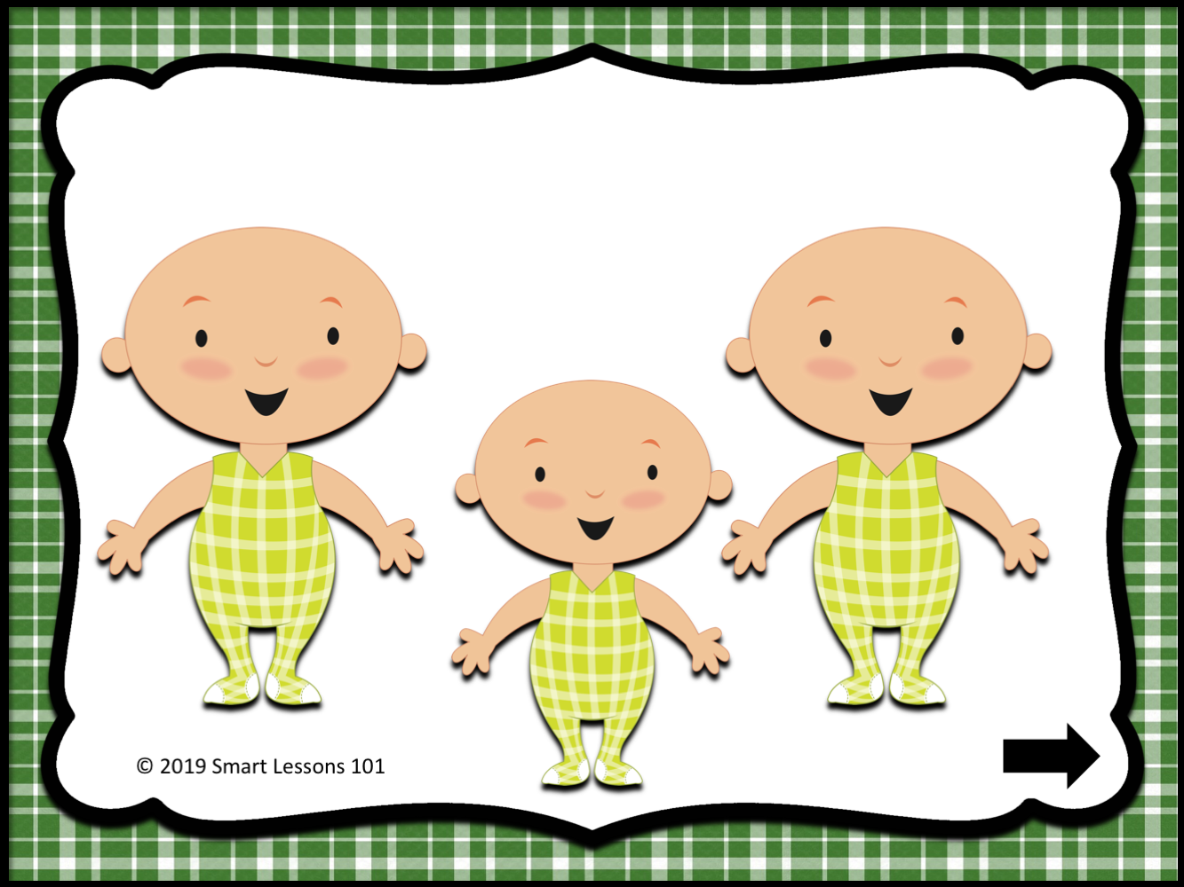

Slide 6
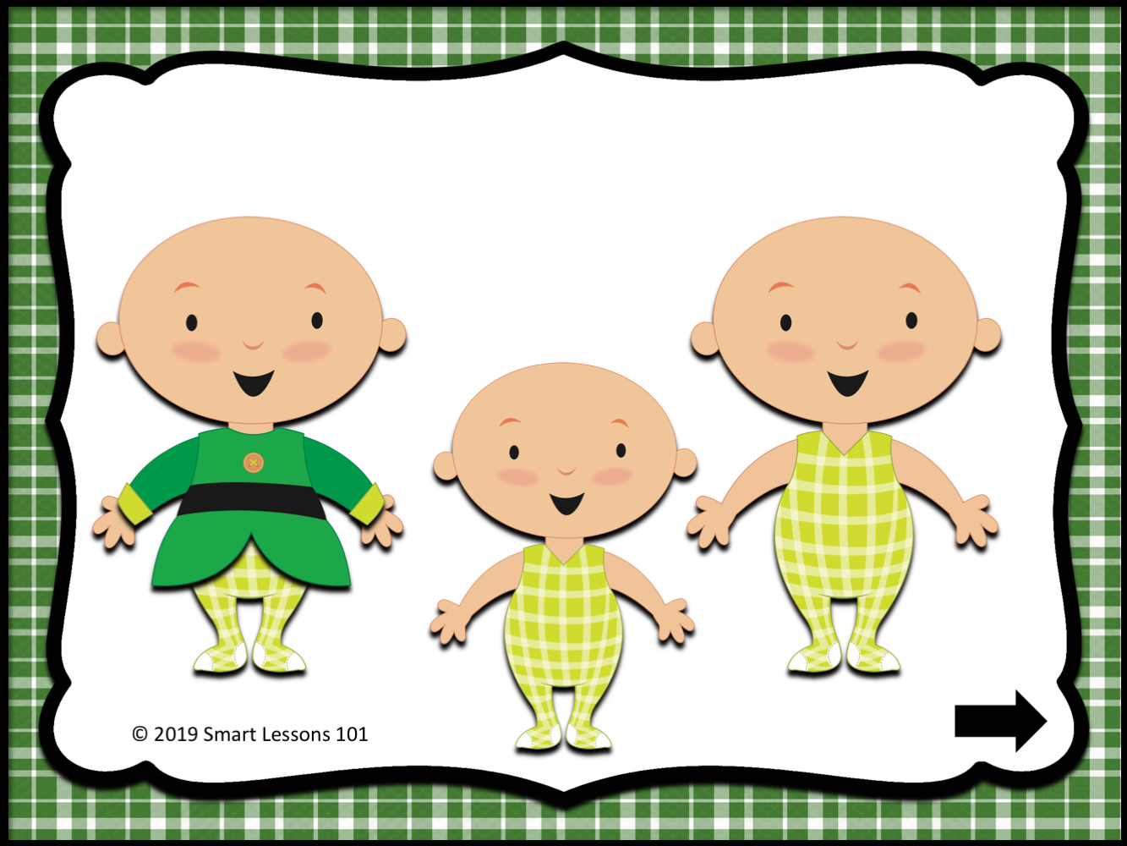

Slide 7
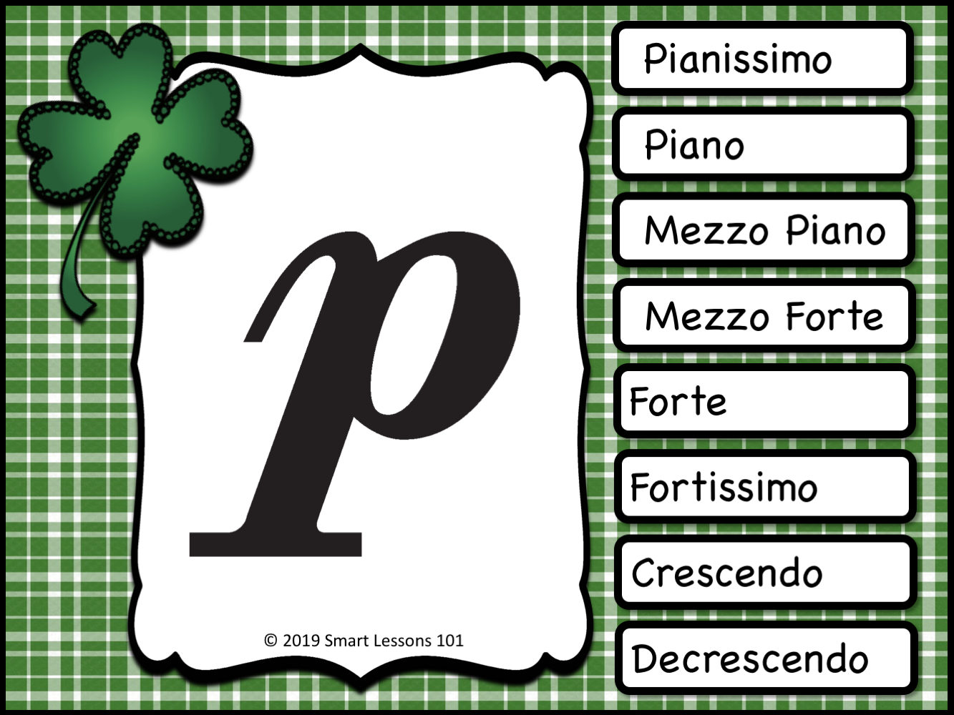
Mezzo Forte
Forte
Fortissimo
Crescendo
Decrescendo

Slide 9
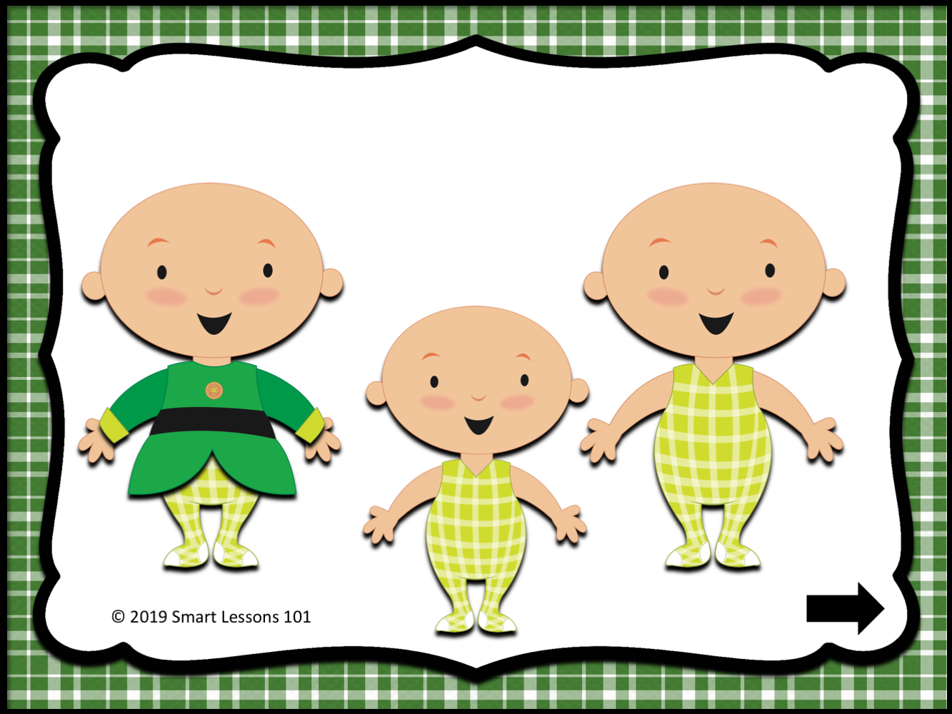

Slide 10
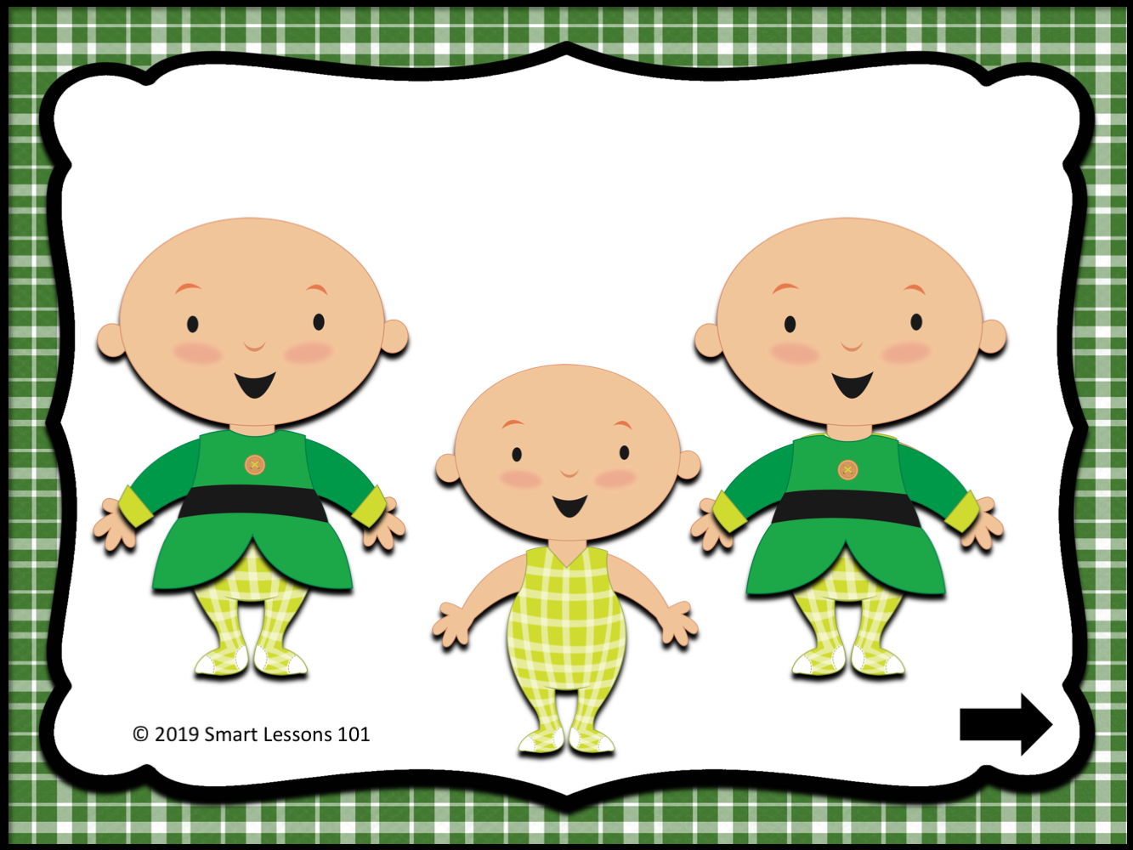

Slide 11
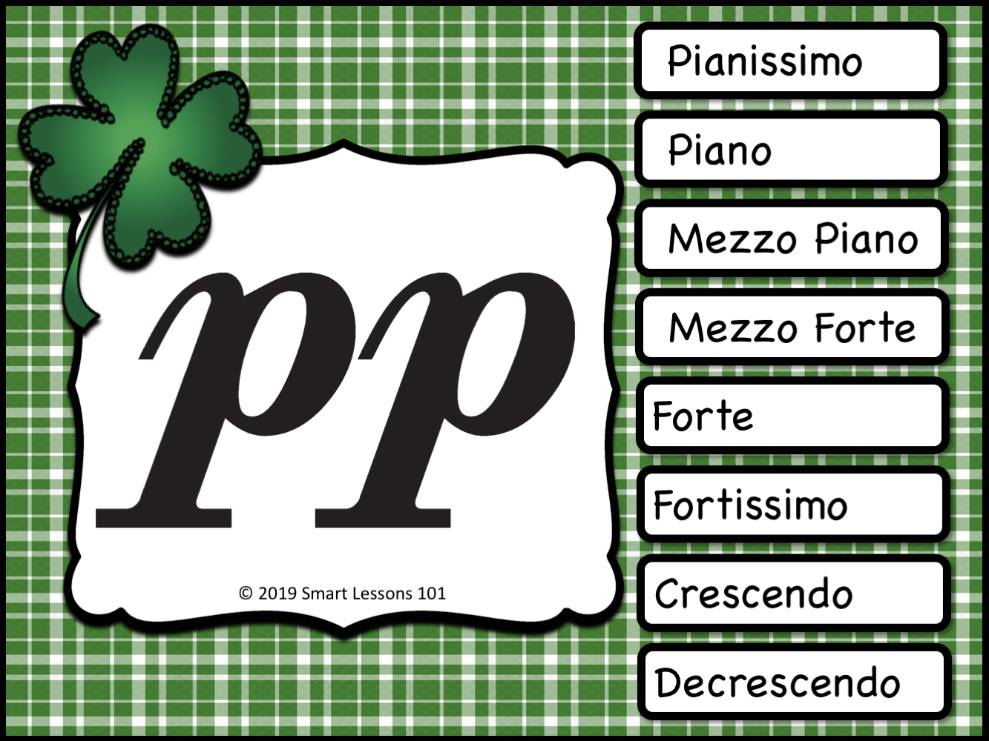

Slide 14
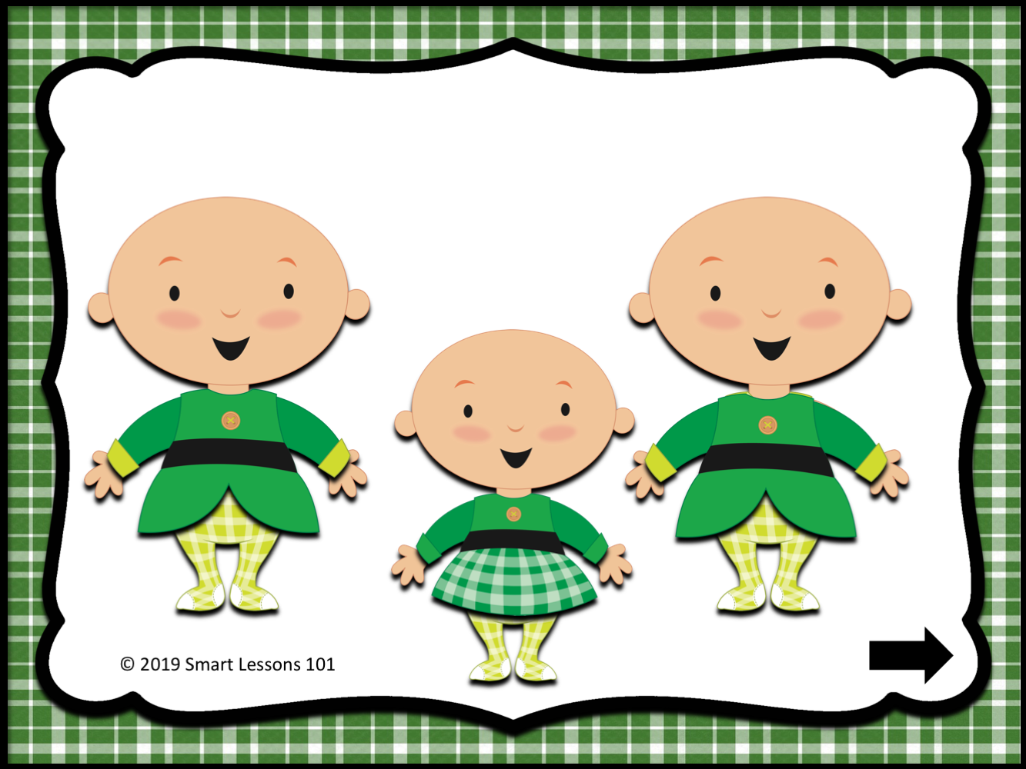

Slide 15
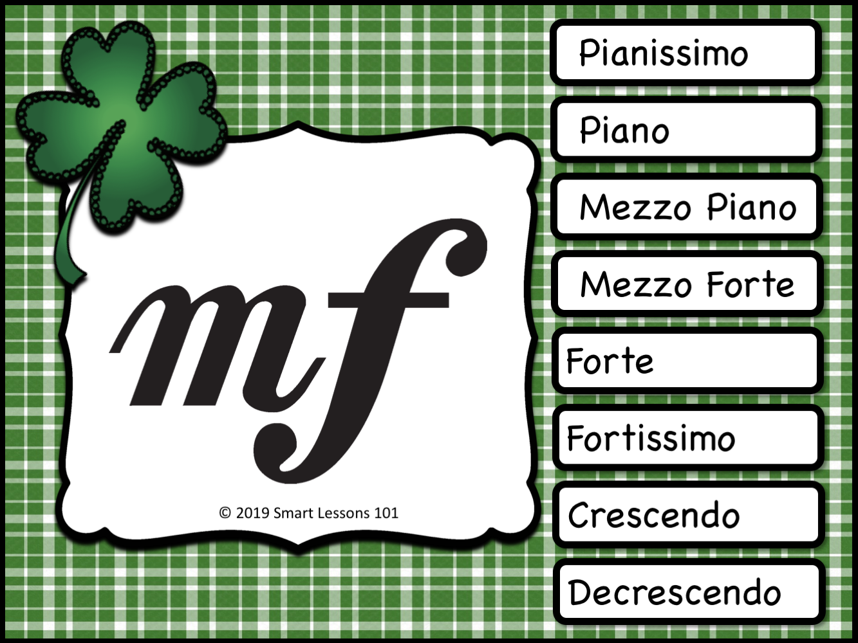

Slide 18
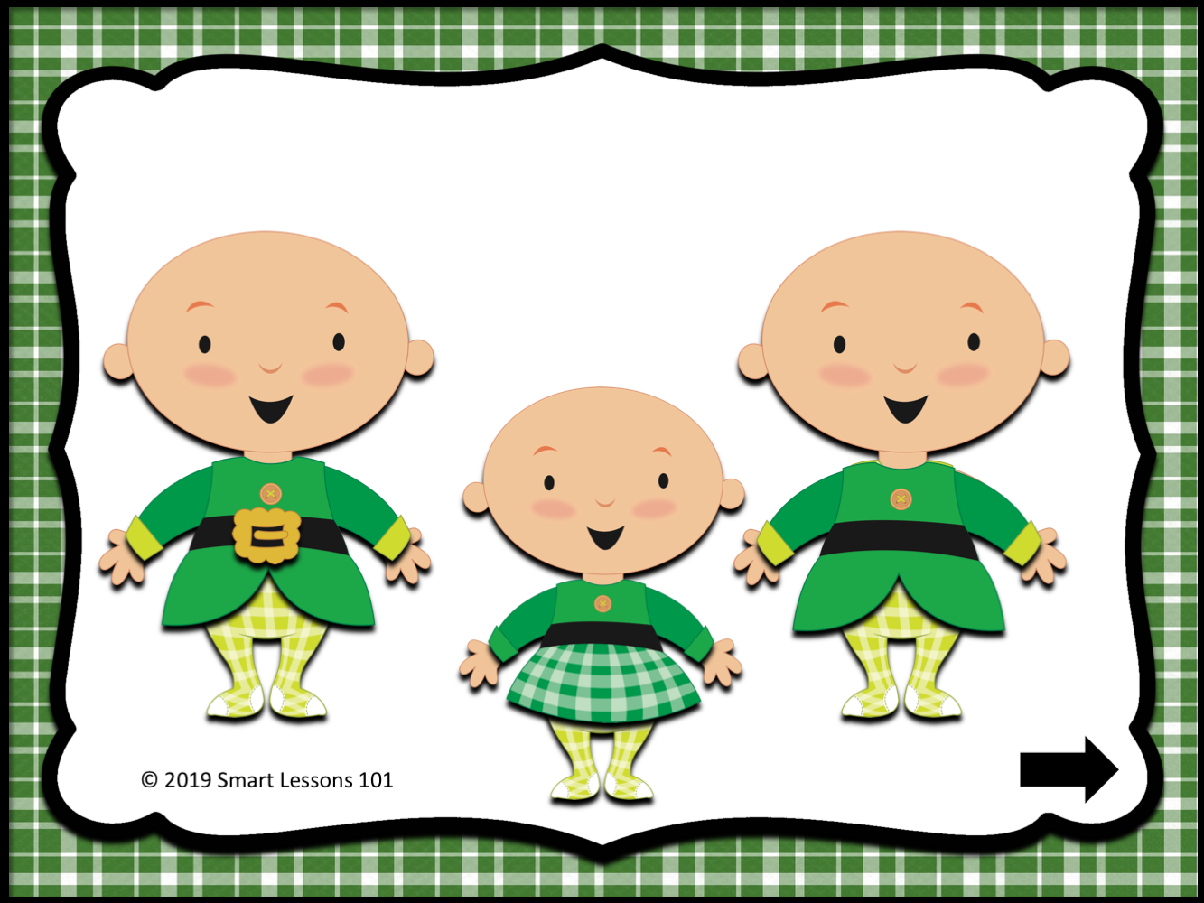

Slide 19
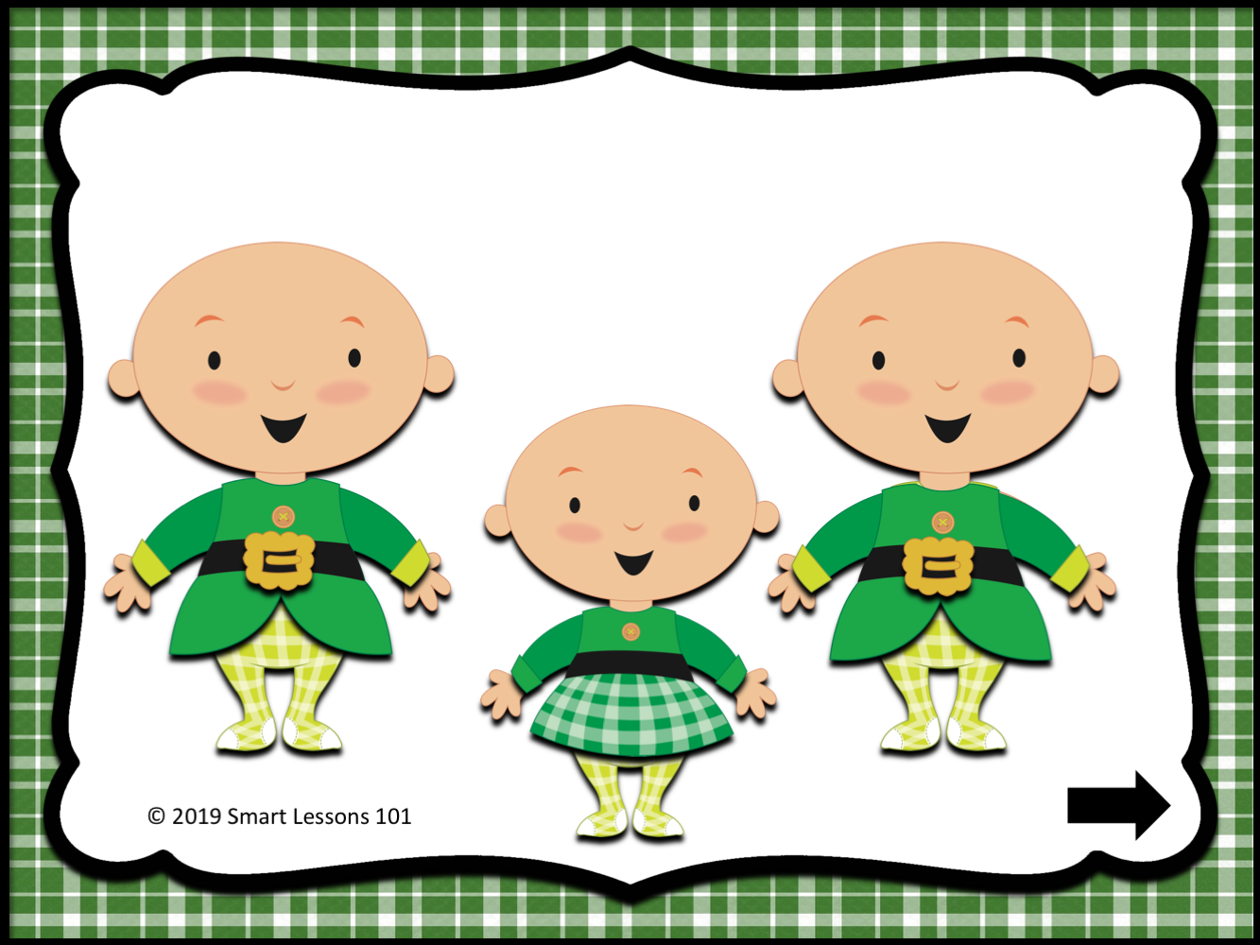

Slide 20
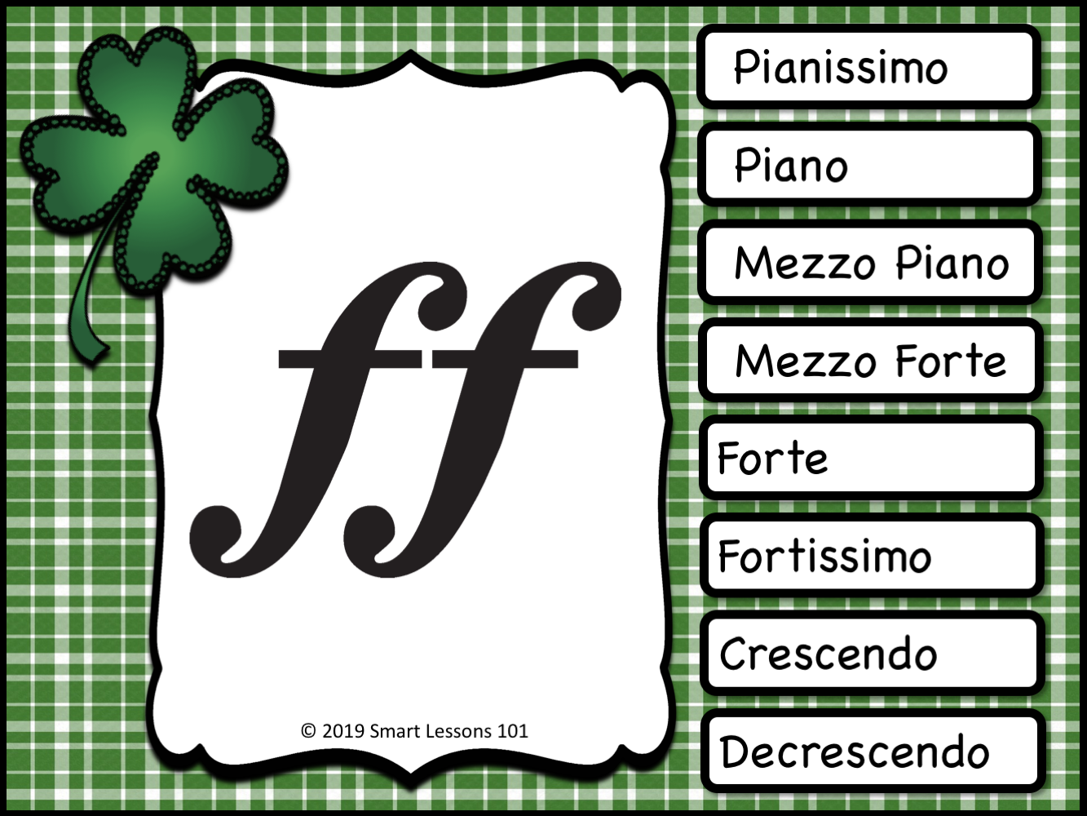

Slide 23
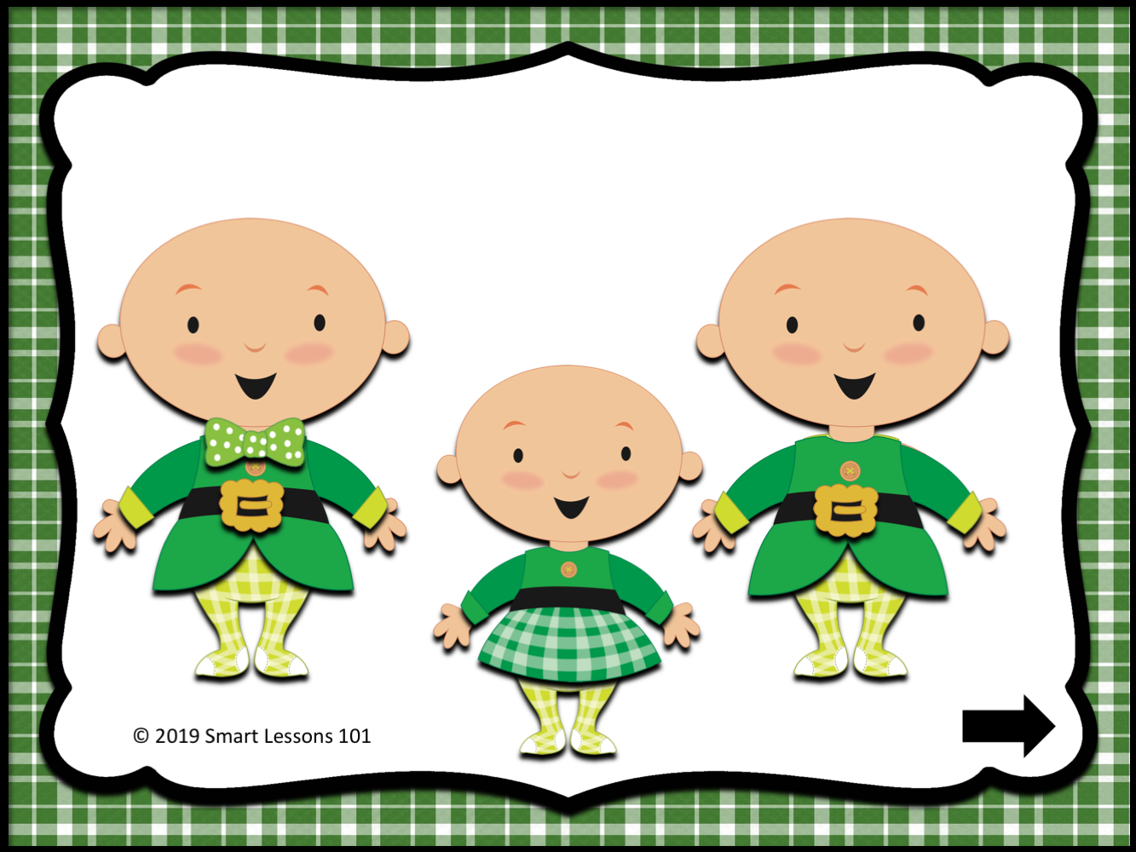

Slide 24
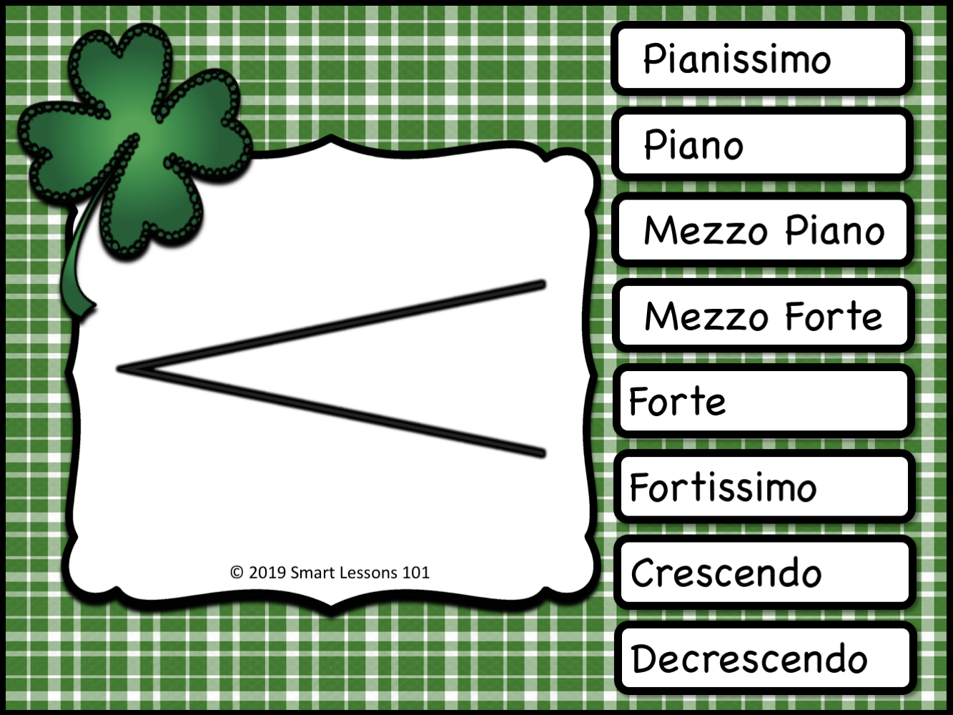

Slide 26


Slide 27
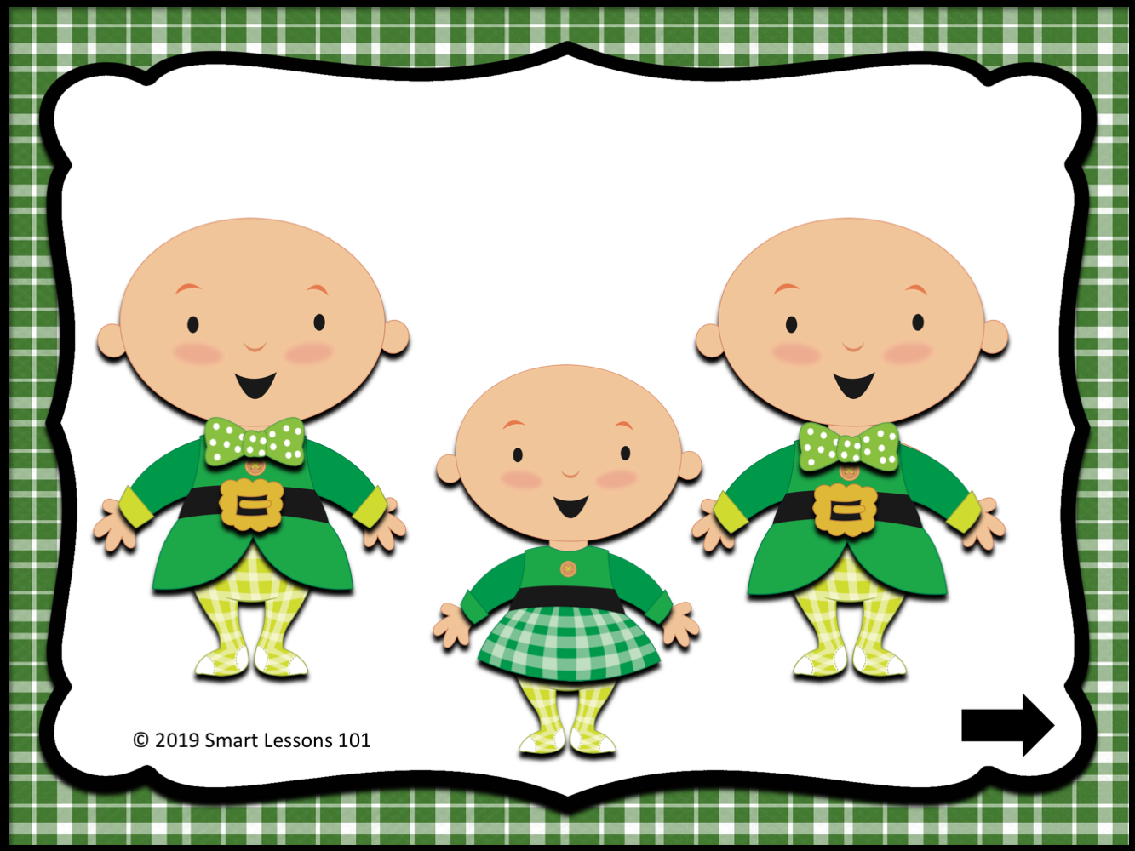

Slide 28
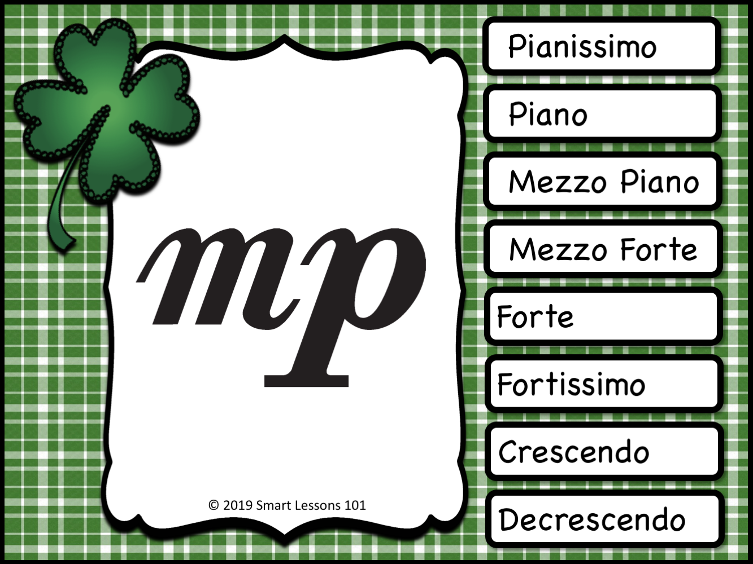
Pianissimo
Piano
Mezzo Piano
Mezzo Forte
Forte
Fortissimo
Crescendo
Decrescendo

Slide 31
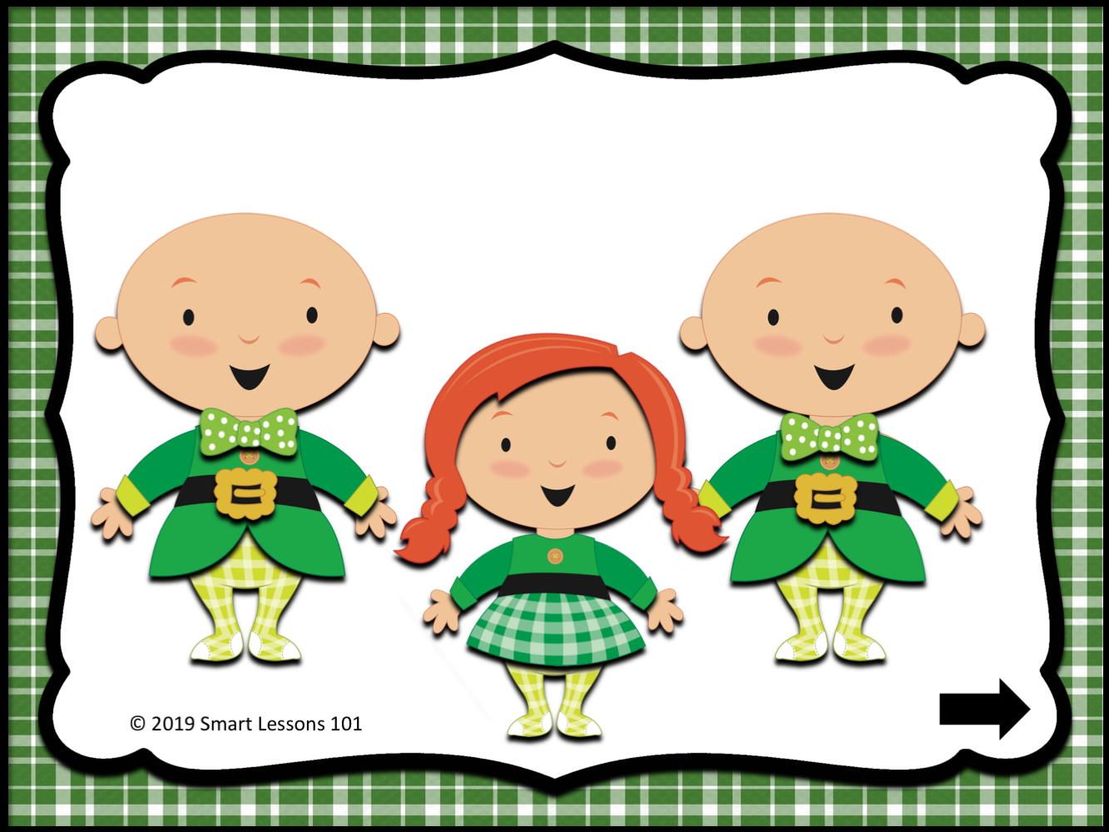

Slide 32
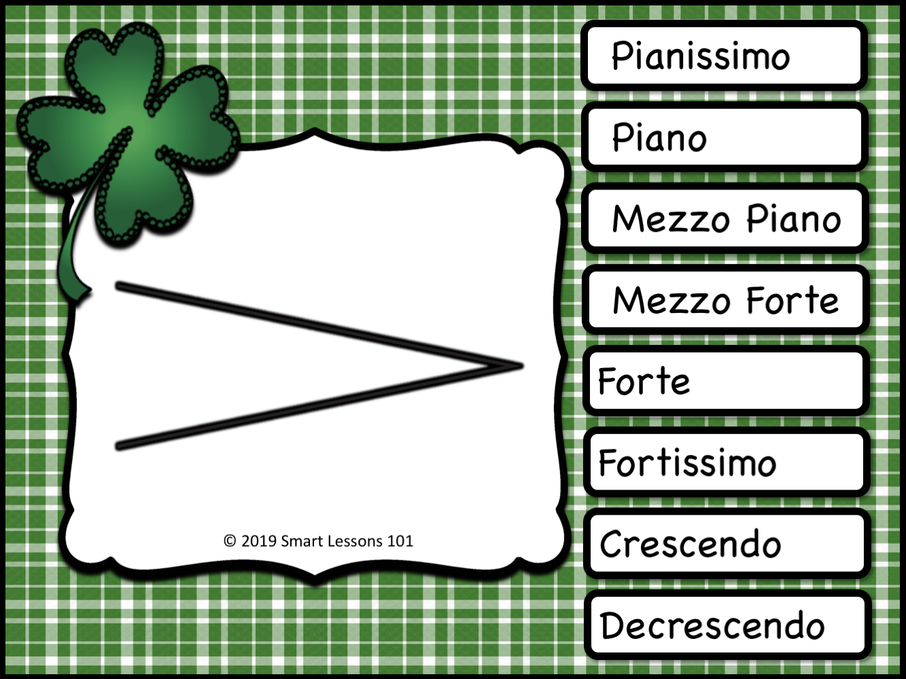
Pianissimo
Piano
Mezzo Piano
Mezzo Forte
Forte
Fortissimo
Crescendo
Decrescendo

Slide 35
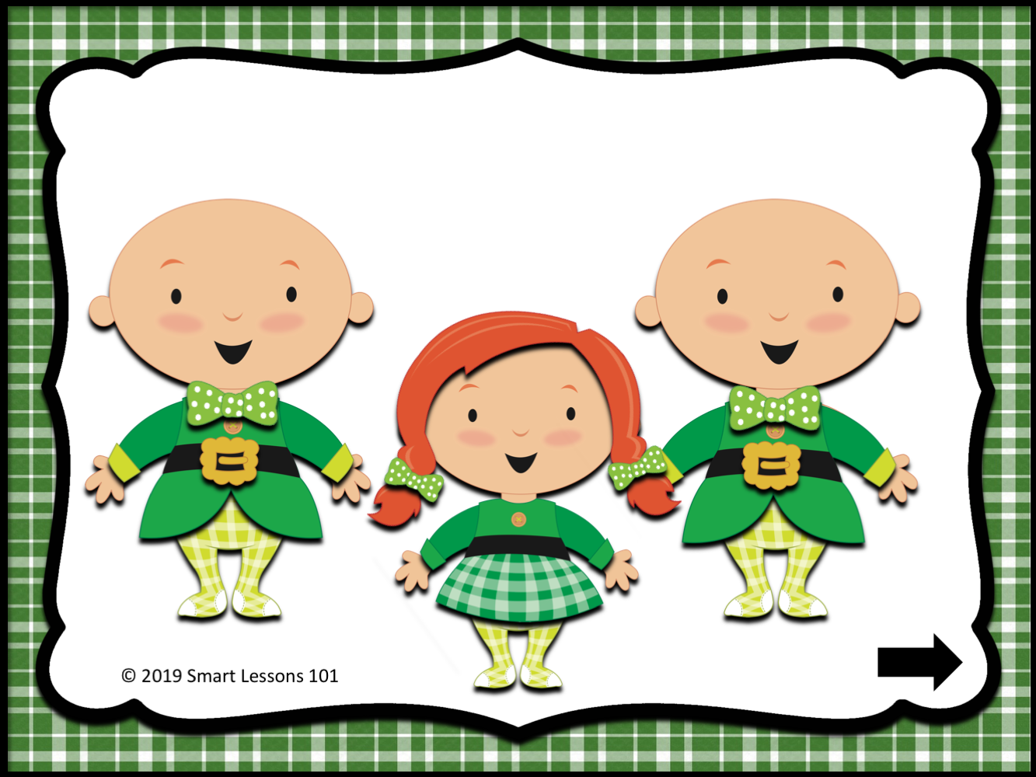

Slide 36

Pianissimo
Piano
Mezzo Piano
Mezzo Forte
Forte
Fortissimo
Crescendo
Decrescendo

Slide 39
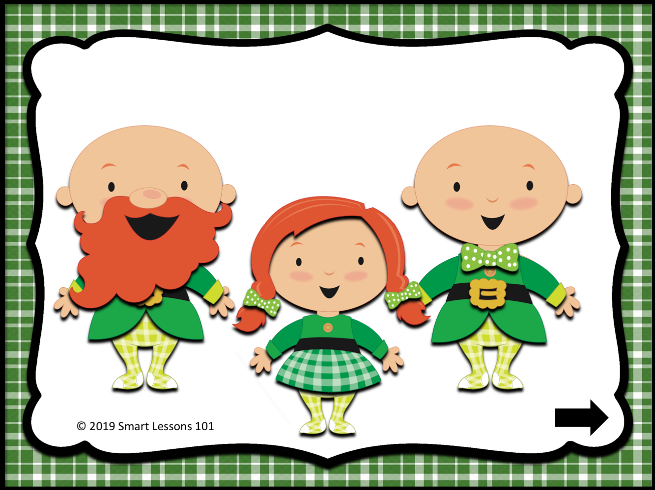

Slide 40
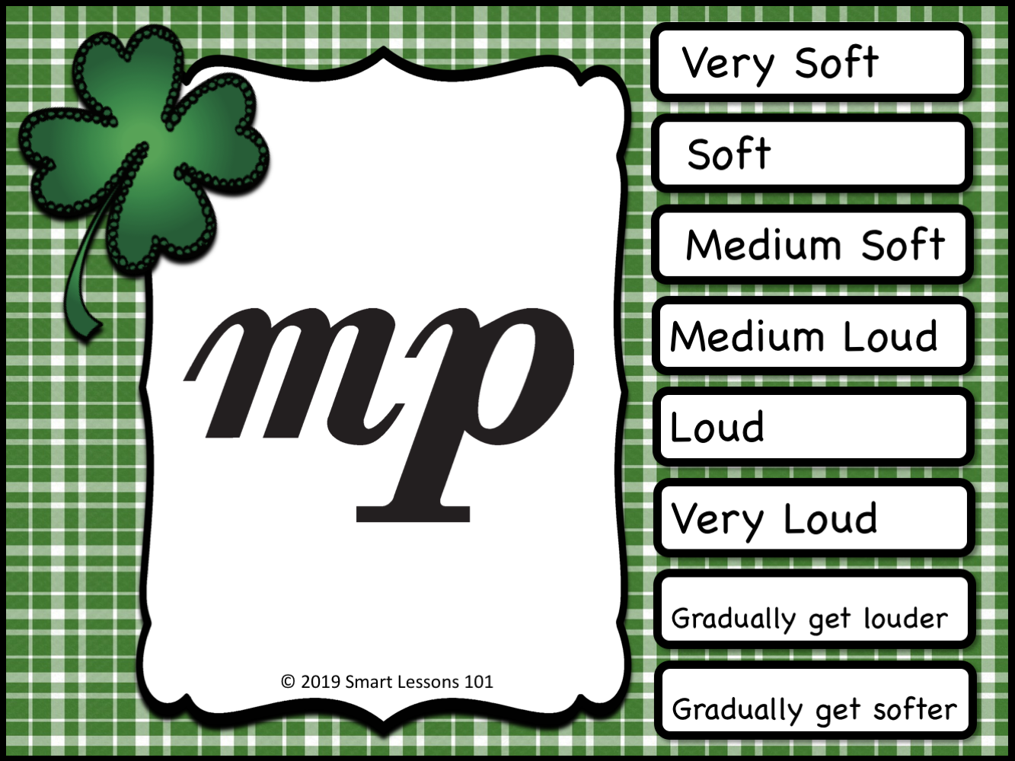
Pianissimo
Piano
Mezzo Piano
Mezzo Forte
Forte
Fortissimo
Crescendo
Decrescendo

Slide 43
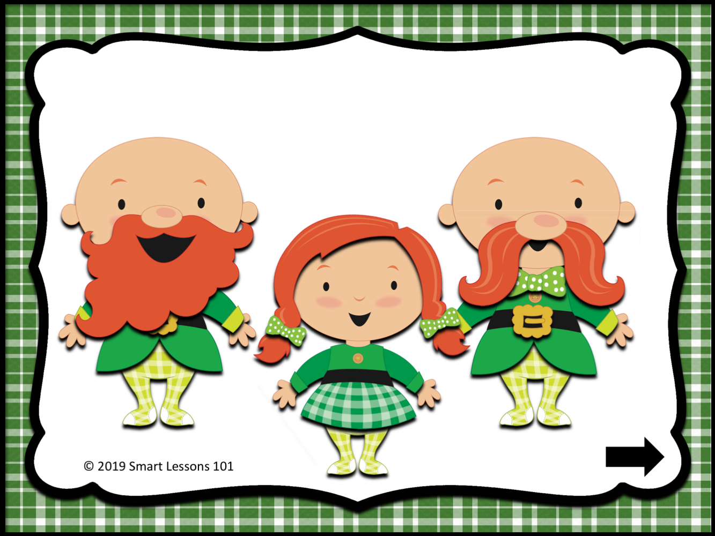

Slide 44
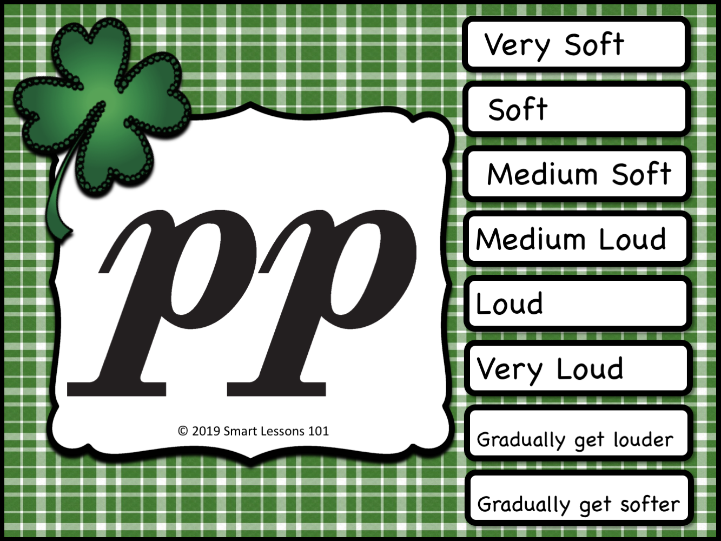
Pianissimo
Piano
Mezzo Piano
Mezzo Forte
Forte
Fortissimo
Crescendo
Decrescendo

Slide 47
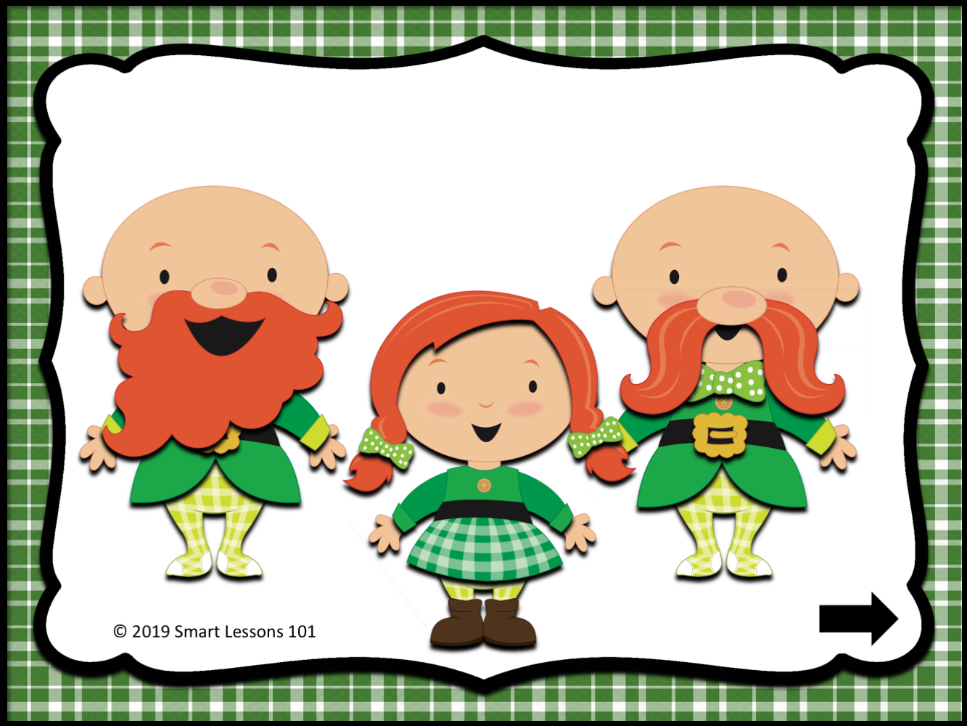

Slide 48
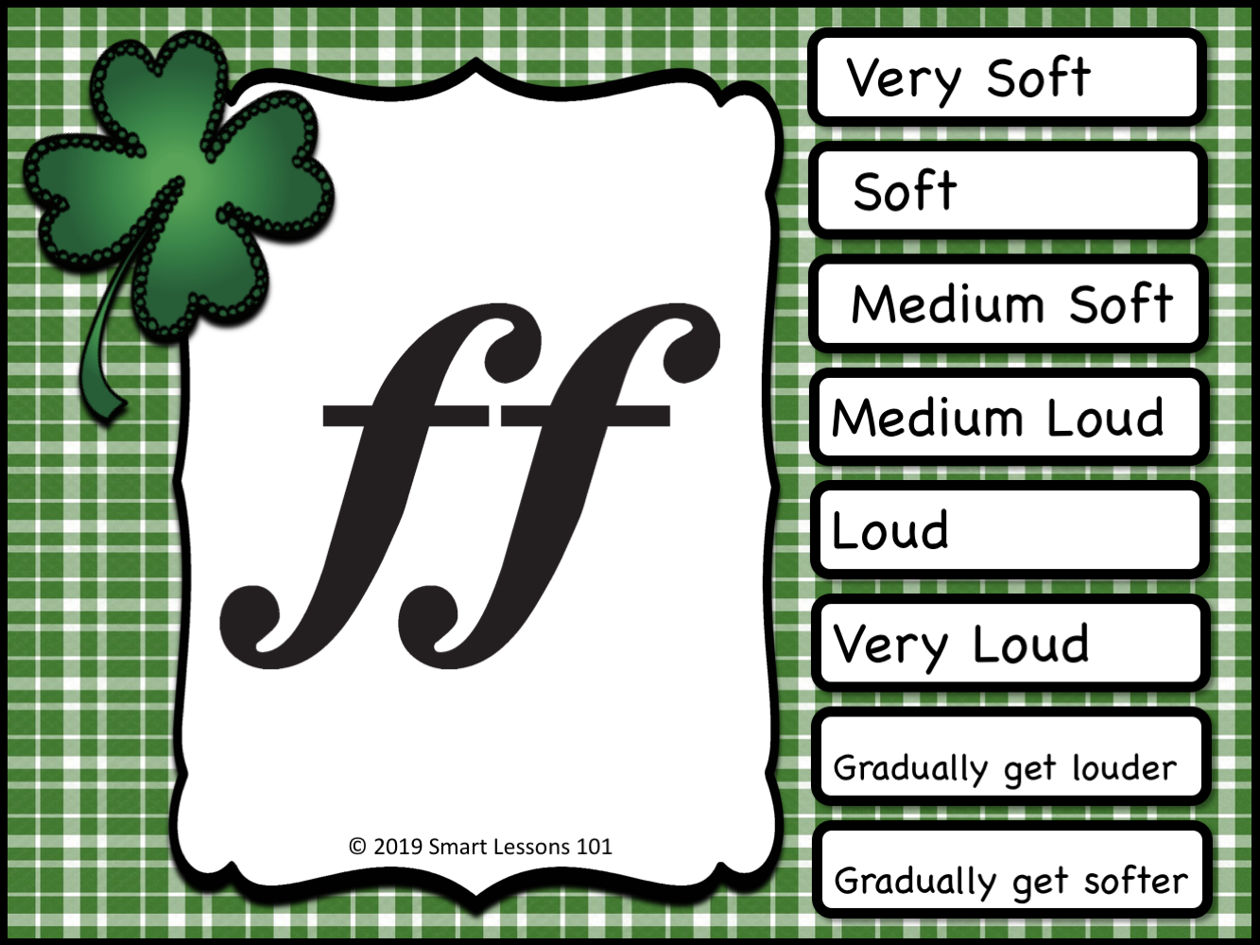
Pianissimo
Piano
Mezzo Piano
Mezzo Forte
Forte
Fortissimo
Crescendo
Decrescendo

Slide 51
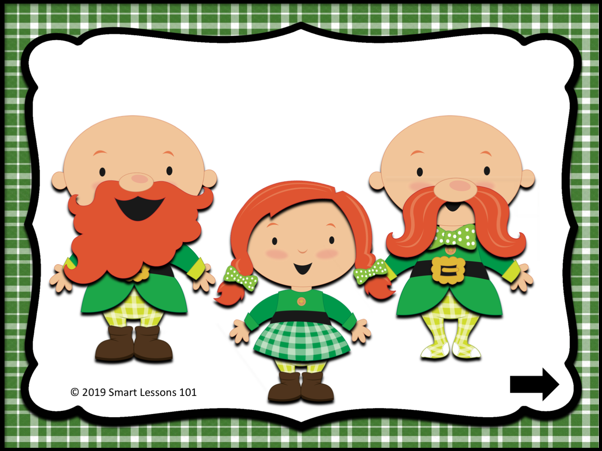

Slide 52

Pianissimo
Piano
Mezzo Piano
Mezzo Forte
Forte
Fortissimo
Crescendo
Decrescendo

Slide 55
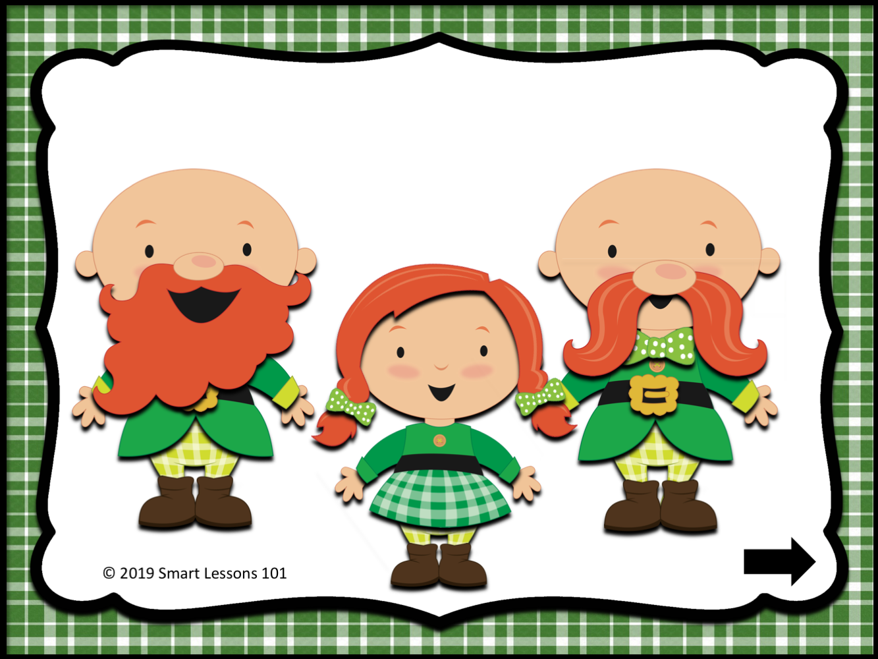

Slide 56
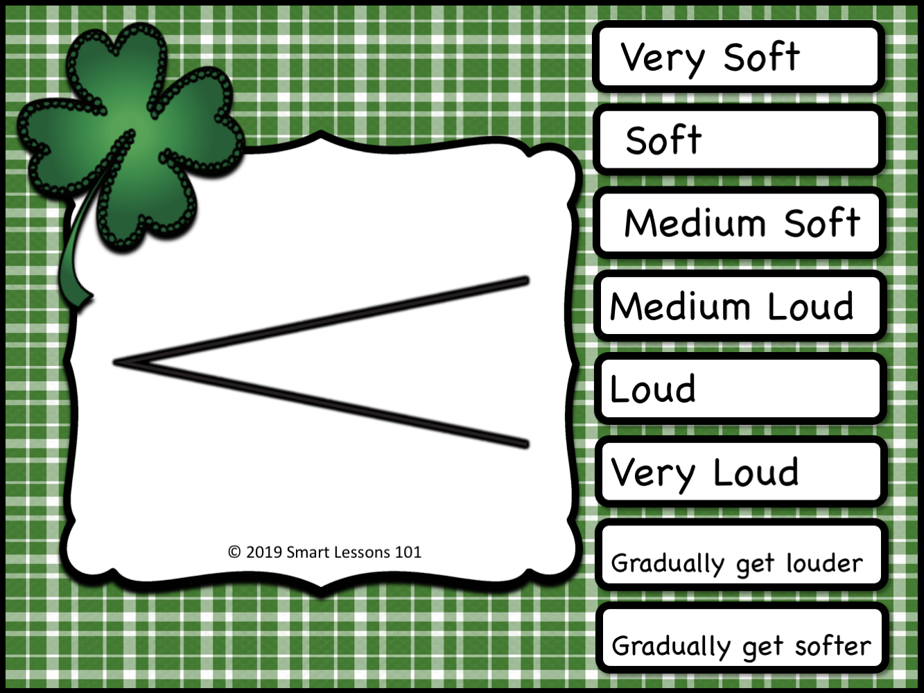
Pianissimo
Piano
Mezzo Piano
Mezzo Forte
Forte
Fortissimo
Crescendo
Decrescendo

Slide 59
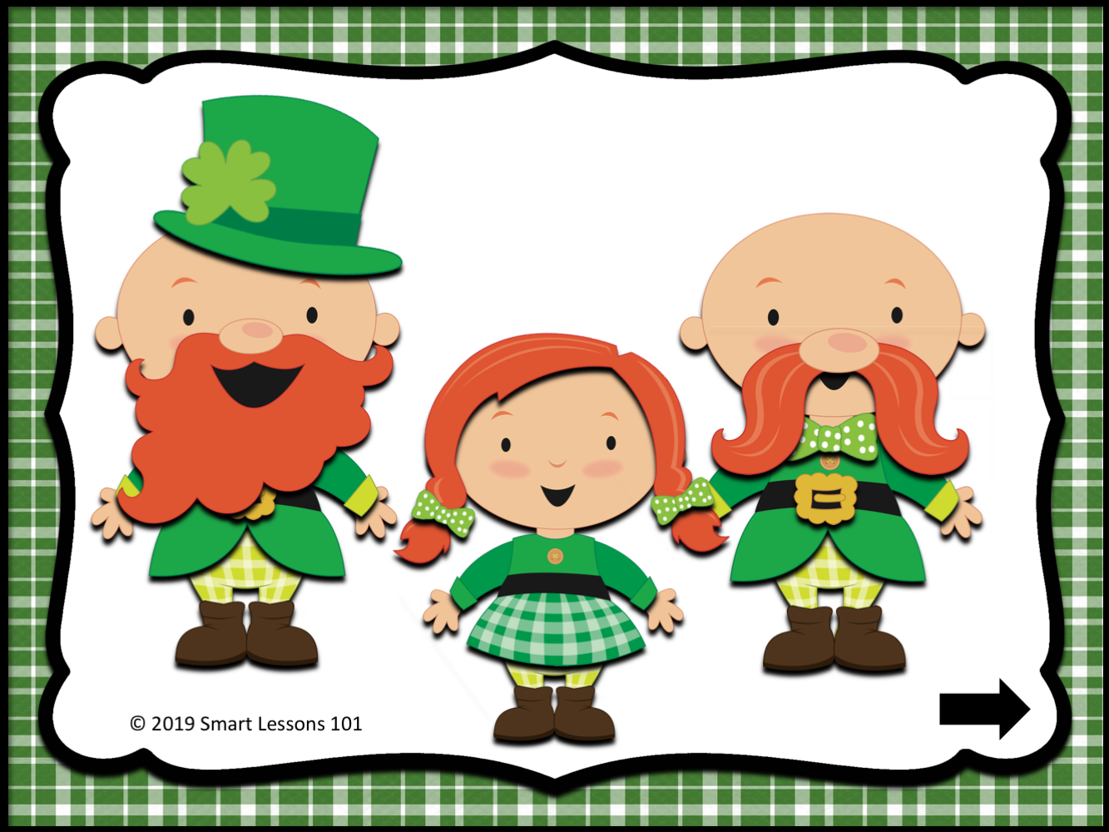

Slide 60
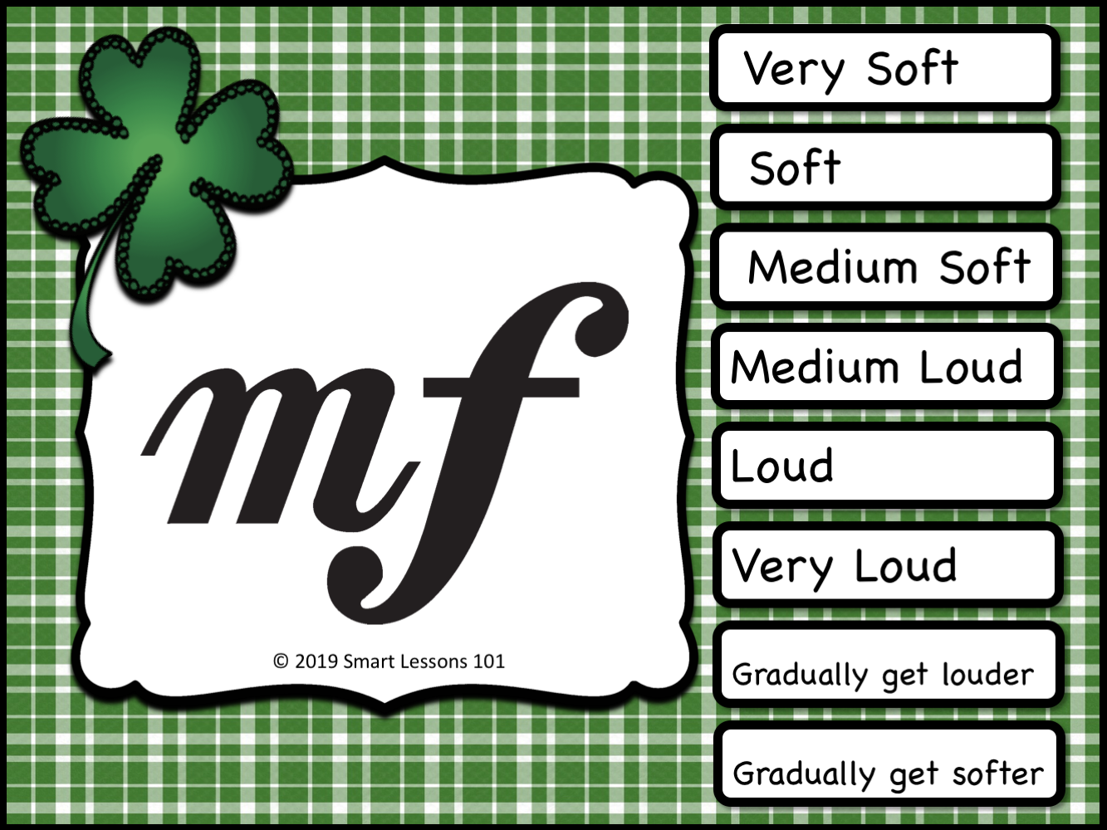
Pianissimo
Piano
Mezzo Piano
Mezzo Forte
Forte
Fortissimo
Crescendo
Decrescendo

Slide 63
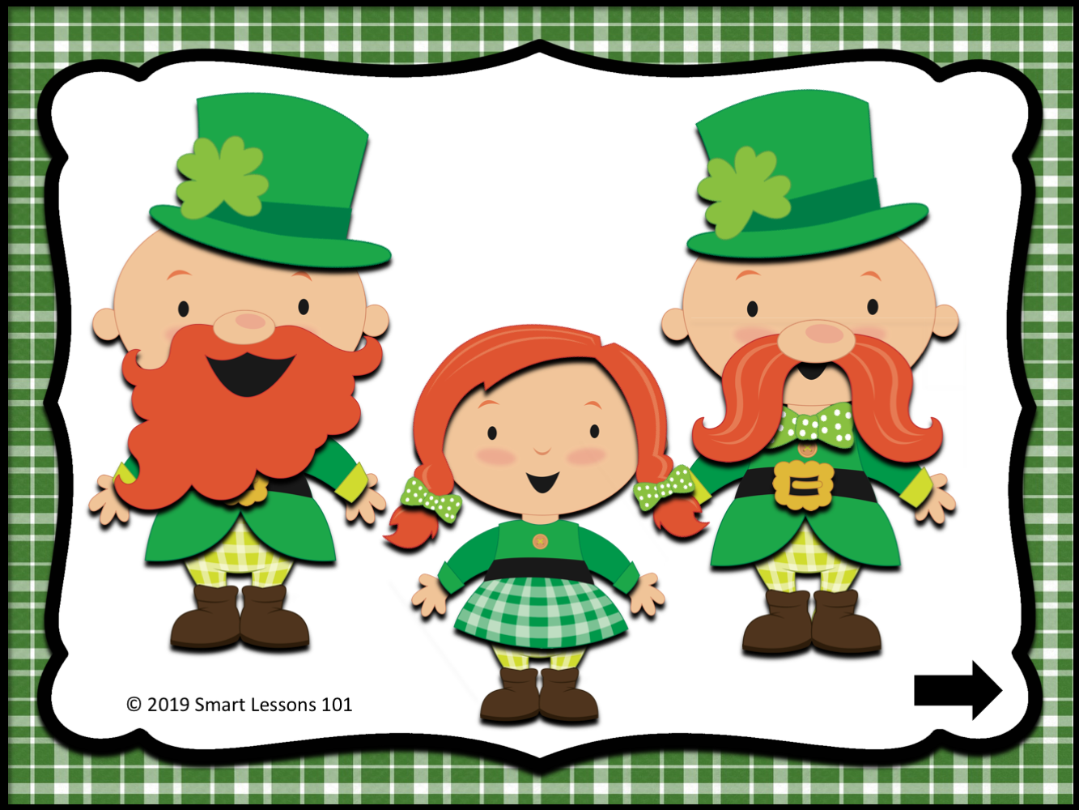

Slide 64
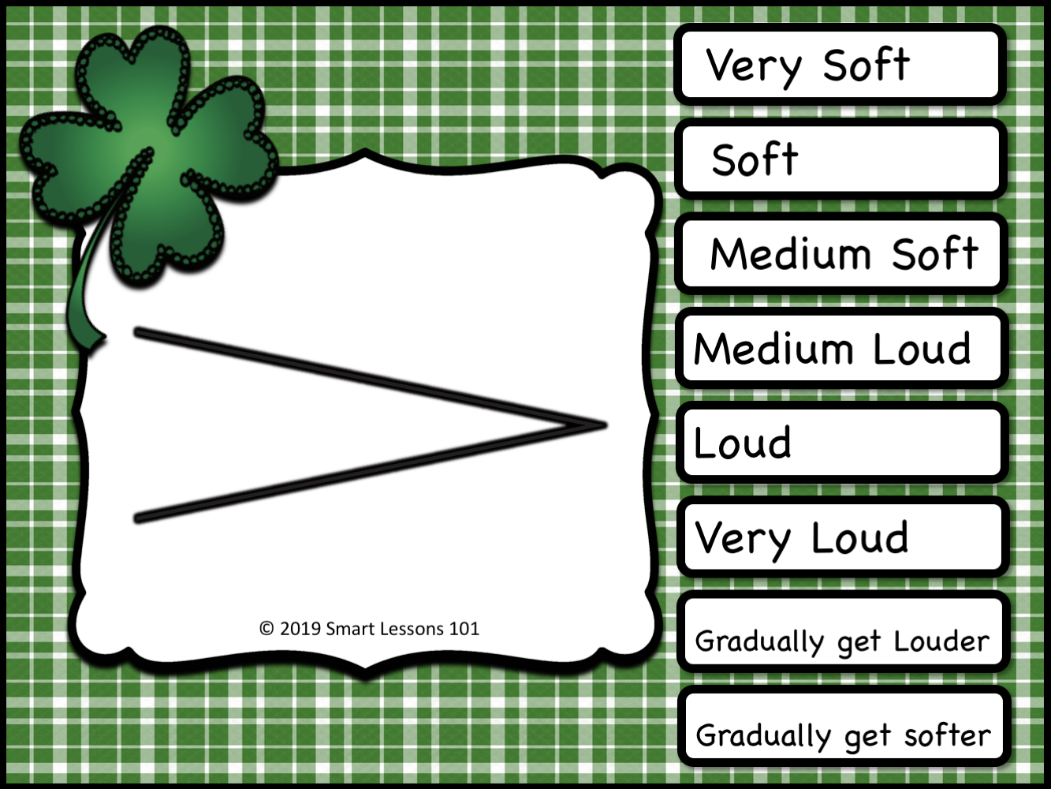
Pianissimo
Piano
Mezzo Piano
Mezzo Forte
Forte
Fortissimo
Crescendo
Decrescendo

Slide 67
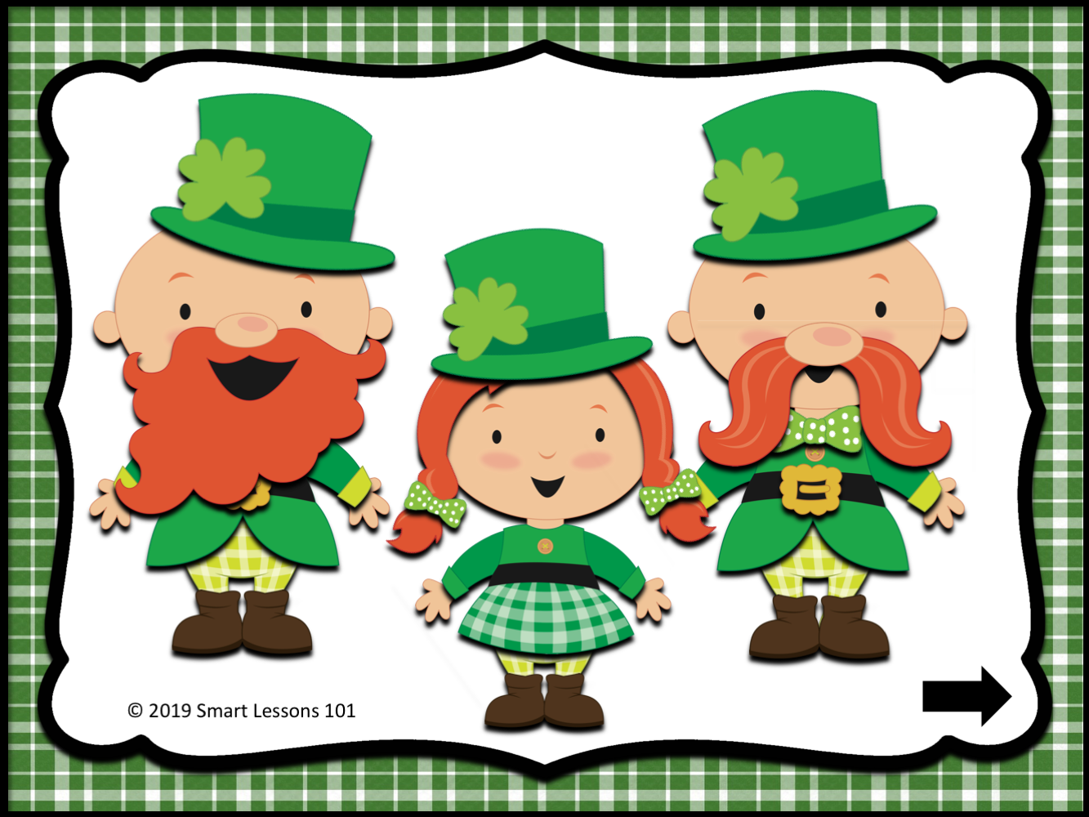

Slide 68
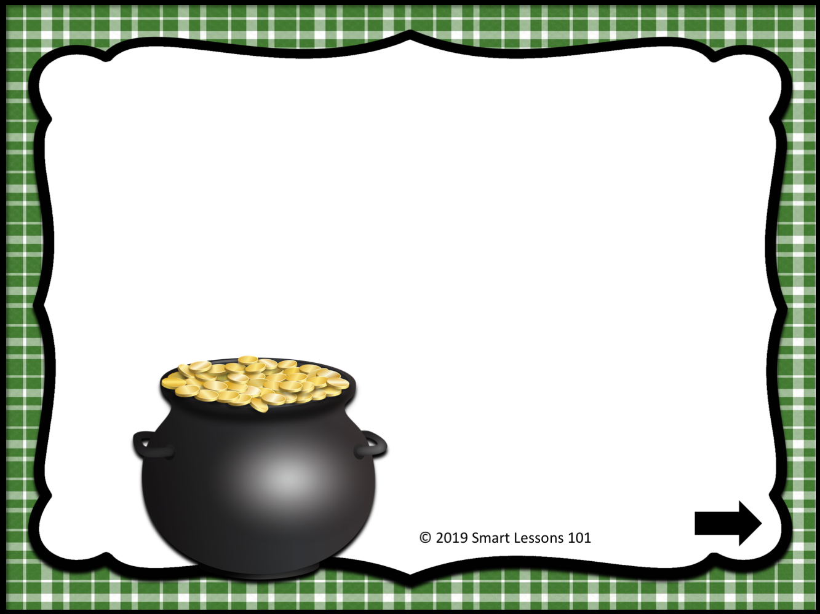

Slide 69
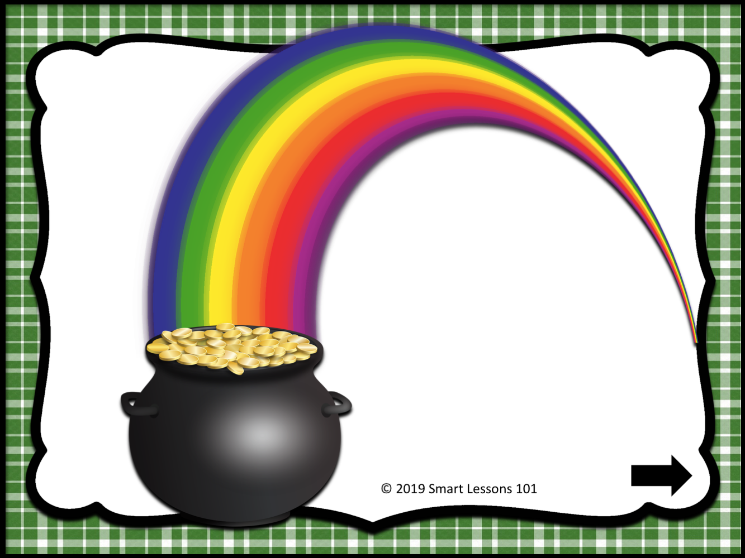

Slide 70


Slide 71


Slide 72

THANK YOU
to the following artists for the clipart
used in the making of this product:
For a Rainy Day https://www.teacherspayteachers.com/Store/For-A-Rainy-Day
Mother’s Music
https://www.teacherspayteachers.com/Store/Mathers-Music/

