Slide 1
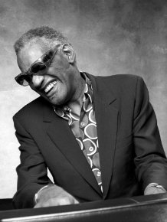
Ray Charles
Georgia On My Mind

Slide 2
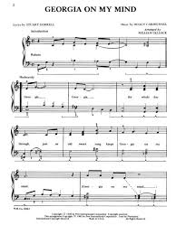
Charles was a pioneer of SOUL music. He was one of the first artists to combine R&B, Gospel, Pop, & Country music. He was known as “the father of soul.”
Some of his most famous songs include:
“Unchain My Heart”
“Georgia On My Mind”
“Hit the Road Jack”

Slide 3
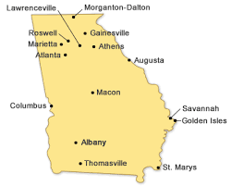
Charles was born in Albany, Georgia on September 23, 1930. He died in 2004.
His father was a mechanic and his mother was a sharecropper. They were very poor.
They moved to Greenville, FL when he was an infant.
By seven years-old, Charles had lost his sight. This was due to glaucoma, a disease in which fluid lays on the optic nerve and permanently damages the eyes, often causing blindness.
His mother sent him to a special school from 1937-1945: Florida School for the Deaf and the Blind in St. Augustine, Florida.
Here, he learned to use Braille to read and write.
He also learned to play several instruments: piano, organ, sax, clarinet and trumpet.

Slide 4
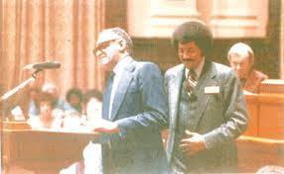
Georgia On my mind
Charles won three Grammy’s during his career. His first Grammy was for the song Georgia on My Mind, which he recorded in 1960.
In April 1979, Charles’ version of Georgia on My Mind was named the State Song of Georgia.
Charles DID NOT write this song, but he won a Grammy for covering it. Many people have sung the song, but the state of Georgia agreed his version was the best to represent the state.
It was written in 1930. There is an argument that the song was not written about the state of Georgia, but the song writer’s sister, Georgia.
https://www.youtube.com/watch?v=Thls_tMuFkc

