Slide 3
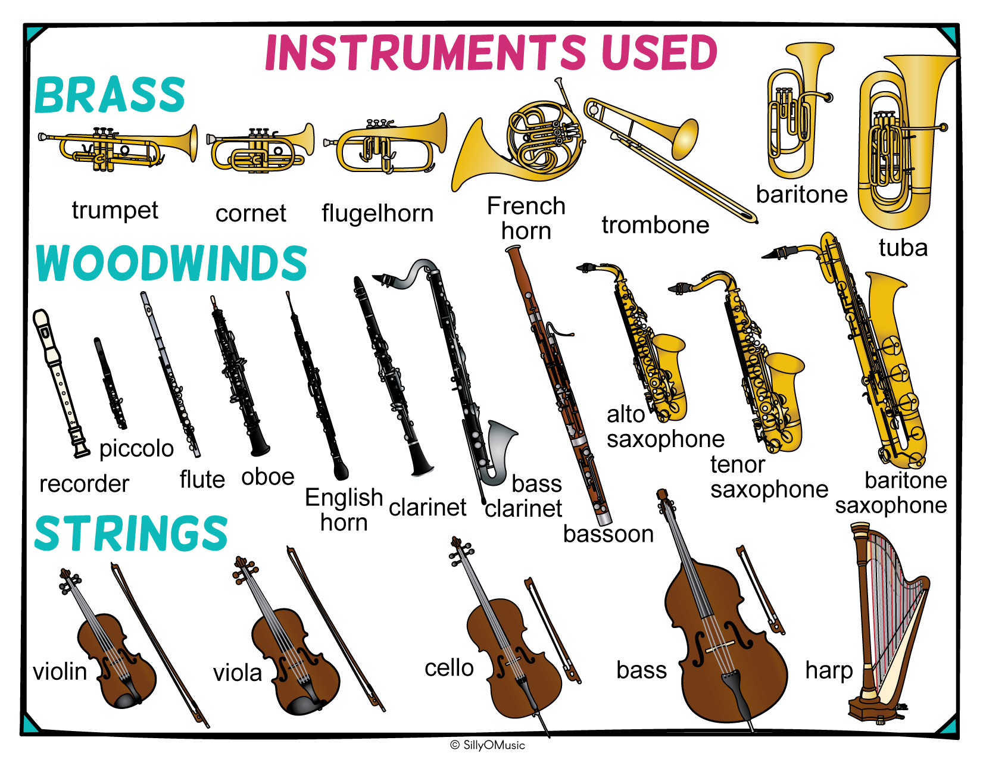

Slide 5
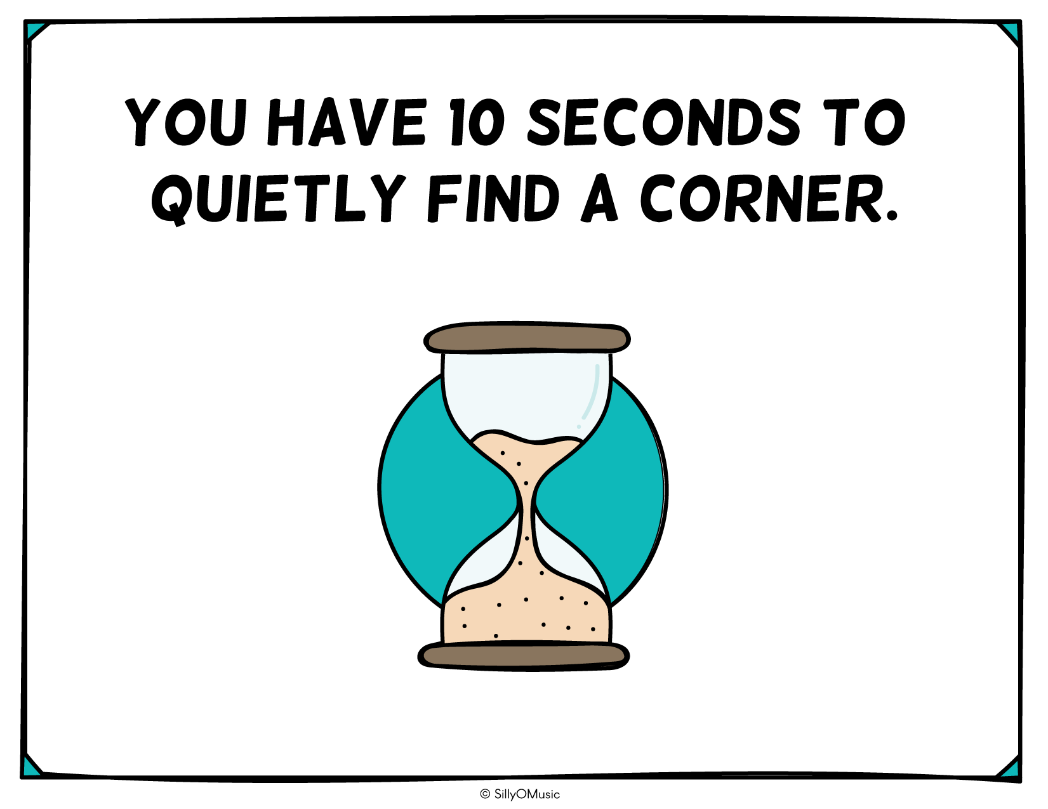
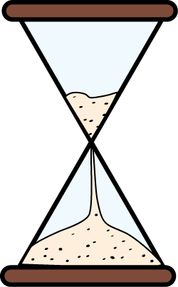

Slide 6
Notes:
Corner #4 – Violin Hint: You can tell it apart from the viola because the violin is much shorter than the bow.

Slide 8
Notes:
Corner #3 – Alto Saxophone

Slide 10
Notes:
Corner #1 – Cymbals

Slide 12
Notes:
Corner #4 – Grand Piano

Slide 14
Notes:
Corner #1 - Tuba

Slide 16
Notes:
Corner #3 – Flute

Slide 18
Notes:
Corner #2 - Trumpet

Slide 20
Notes:
Corner #4 – Timpani

Slide 22
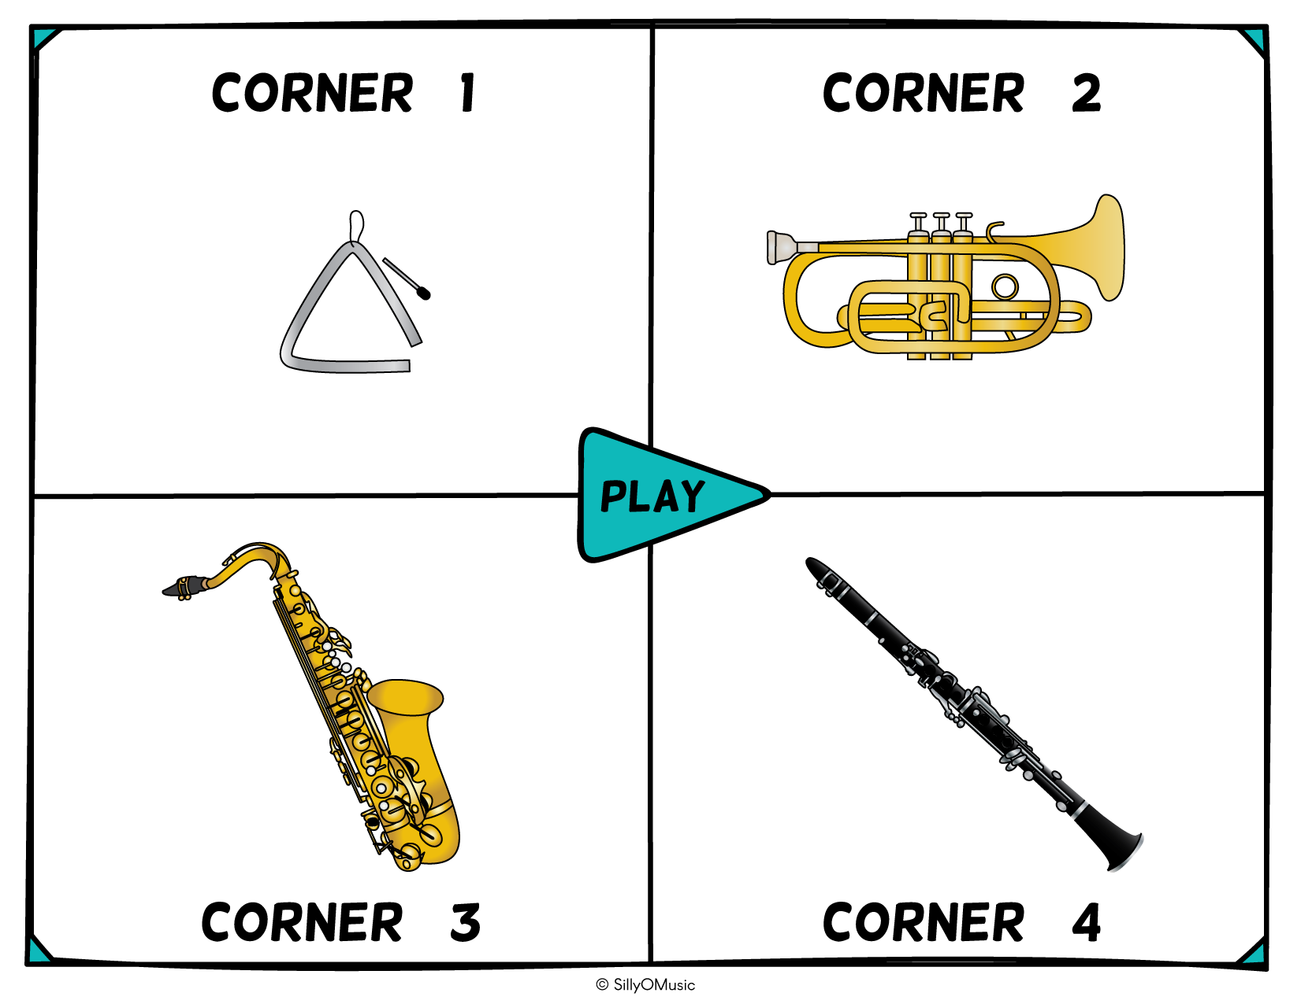
Notes:
Corner #1 - Triangle

Slide 24
Notes:
Corner #2 - Recorder

Slide 26
Notes:
Corner #3 – Celesta

Slide 28
Notes:
Corner #3 – Baritone Saxophone

Slide 30
Notes:
Corner #2 - Chimes

Slide 32
Notes:
Corner #2 – Tambourine

Slide 34
Notes:
Corner #1 – Harpsichord

Slide 36
Notes:
Corner #1 – Trombone

Slide 38
Notes:
Corner #4 – Pipe Organ

Slide 40
Notes:
Corner #2 – Cello Hint: The cello has an endpin.

Slide 42
Notes:
Corner #3 – Chime Tree/Mark Tree

Slide 44
Notes:
Corner #3 – Tenor Saxophone

Slide 46
Notes:
Corner #4 – Viola

Slide 48
Notes:
Corner #2 – Clarinet

Slide 50
Notes:
Corner #2 – Snare Drum

Slide 52
Notes:
Corner #2 – Marimba

Slide 54
Notes:
Corner #3 – Harp

Slide 56
Notes:
Corner #3 – French horn

Slide 58
Notes:
Corner #1 – Trombone

Slide 60
Sound clips by SillyOMusic, Soundsnap, & FreesFx.
SillyOMusic@gmail.com

