Slide 2
Terms of Use
Click here to view the Terms of Use.
Thank you!
SillyOMusic@gmail.com

Slide 4
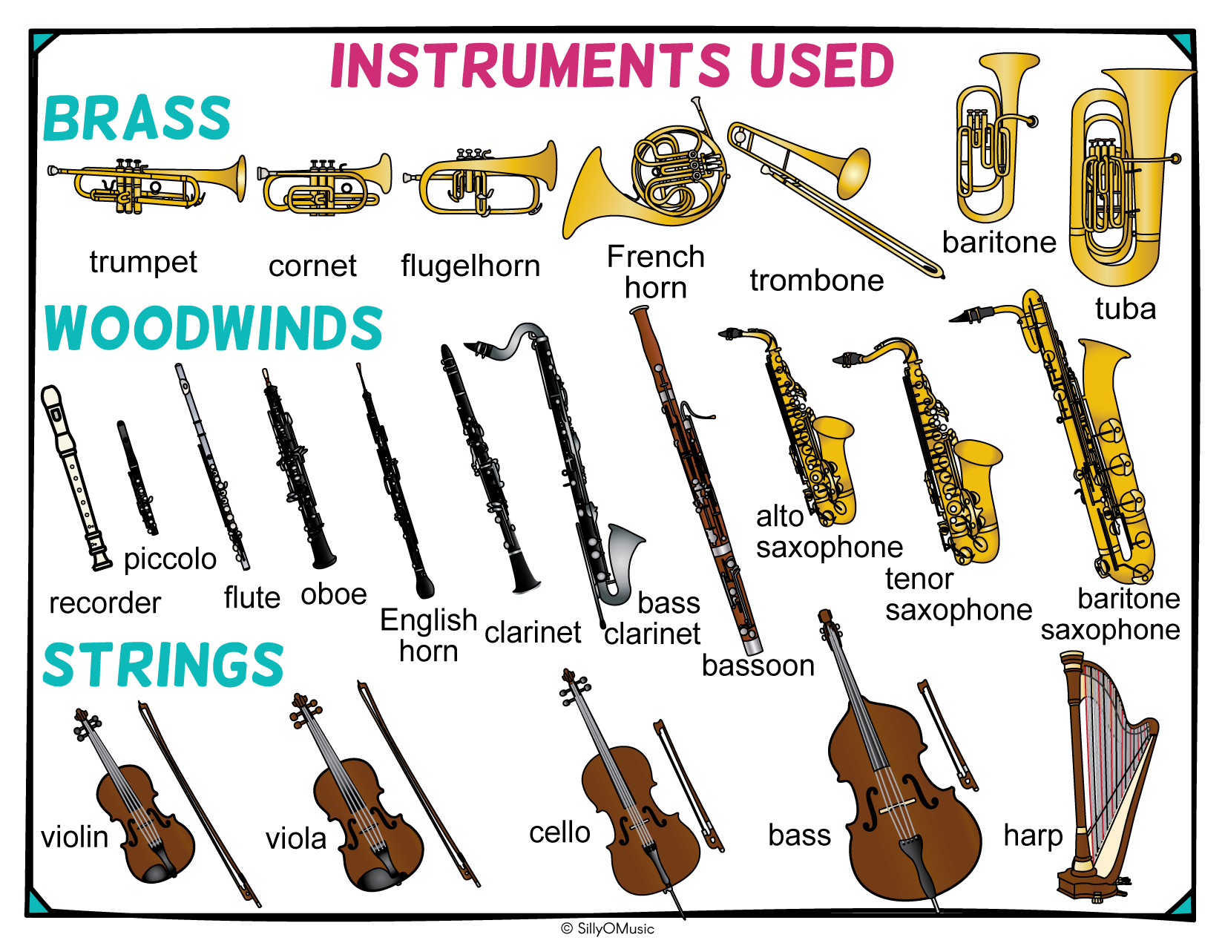

Slide 6
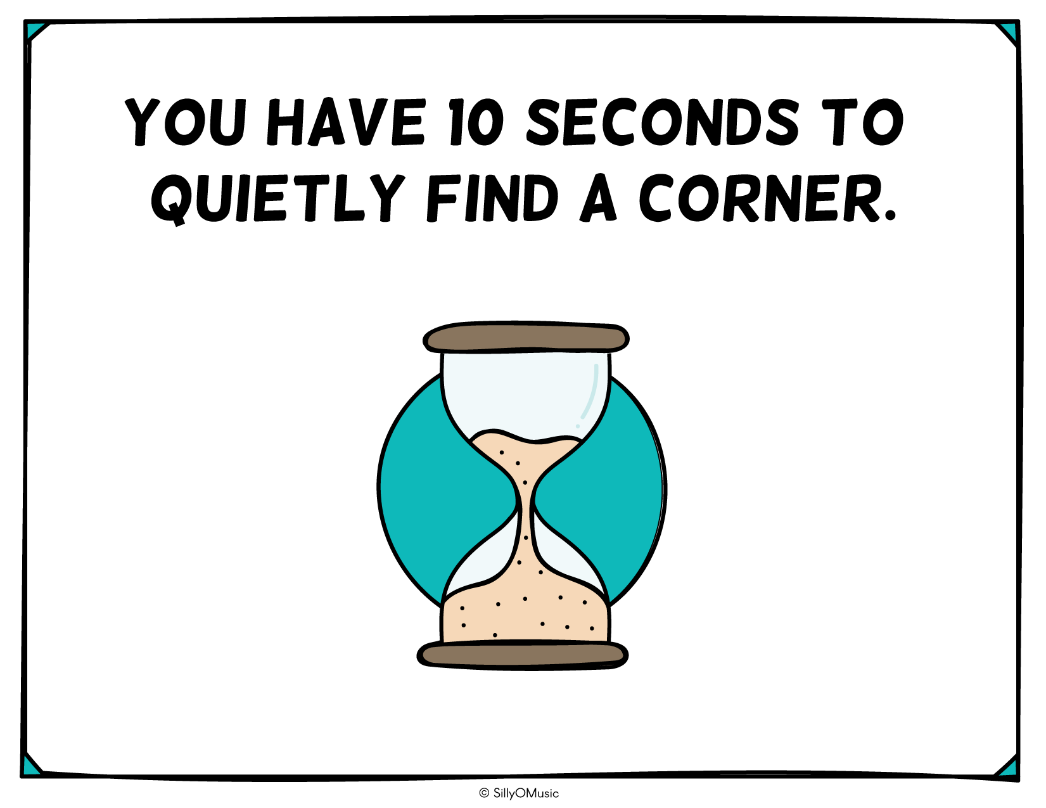
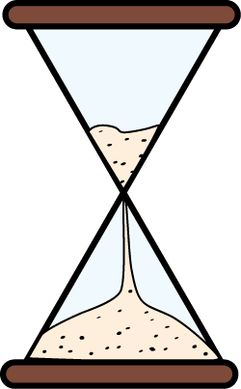

Slide 7
Notes:
Corner #4 – Violin Hint: You can tell it apart from the viola because the violin is much shorter than the bow.

Slide 9
Notes:
Corner #3 – Alto Saxophone

Slide 11
Notes:
Corner #1 – Cymbals

Slide 13
Notes:
Corner #4 – Grand Piano

Slide 15
Notes:
Corner #1 - Tuba

Slide 17
Notes:
Corner #3 – Flute

Slide 19
Notes:
Corner #2 - Trumpet

Slide 21
Notes:
Corner #4 – Timpani

Slide 23
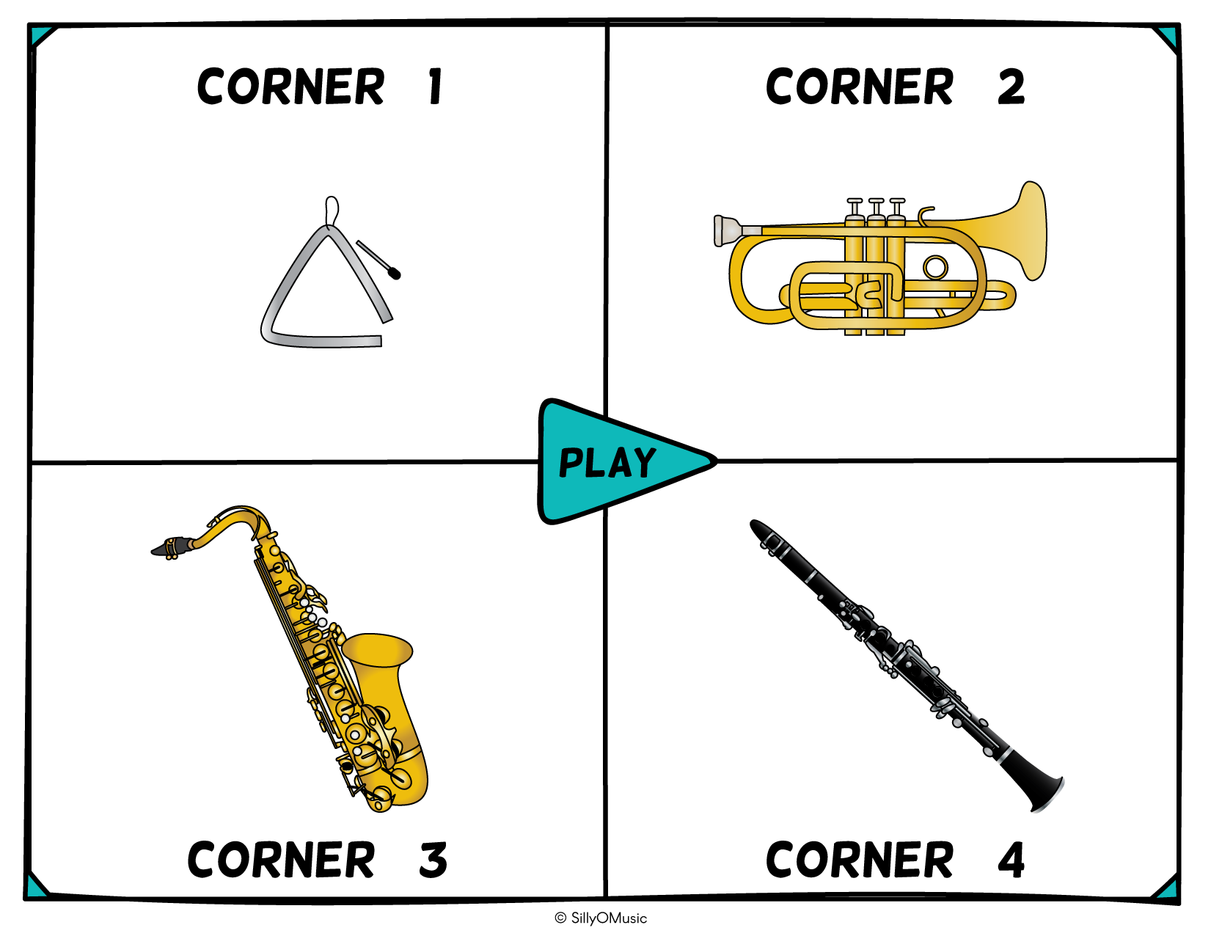
Notes:
Corner #1 - Triangle

Slide 25
Notes:
Corner #2 - Recorder

Slide 27
Notes:
Corner #3 – Celesta

Slide 29
Notes:
Corner #3 – Baritone Saxophone

Slide 31
Notes:
Corner #2 - Chimes

Slide 33
Notes:
Corner #2 – Tambourine

Slide 35
Notes:
Corner #1 – Harpsichord

Slide 37
Notes:
Corner #1 – Trombone

Slide 39
Notes:
Corner #4 – Pipe Organ

Slide 41
Notes:
Corner #2 – Cello Hint: The cello has an endpin.

Slide 43
Notes:
Corner #3 – Chime Tree/Mark Tree

Slide 45
Notes:
Corner #3 – Tenor Saxophone

Slide 47
Notes:
Corner #4 – Viola

Slide 49
Notes:
Corner #2 – Clarinet

Slide 51
Notes:
Corner #2 – Snare Drum

Slide 53
Notes:
Corner #2 – Marimba

Slide 55
Notes:
Corner #3 – Harp

Slide 57
Notes:
Corner #3 – French horn

Slide 59
Notes:
Corner #1 – Trombone

